Slide 1
Gilded Age
Overview

Slide 2
7 Categories of the Gilded Age (Way to help you organize Period 6)
Industrialization
Urbanization
Rise of Big Business
Organization of Workers and Formation of Labor Unions
Westward Expansion
Plight of Farmers
Corruption

Slide 3
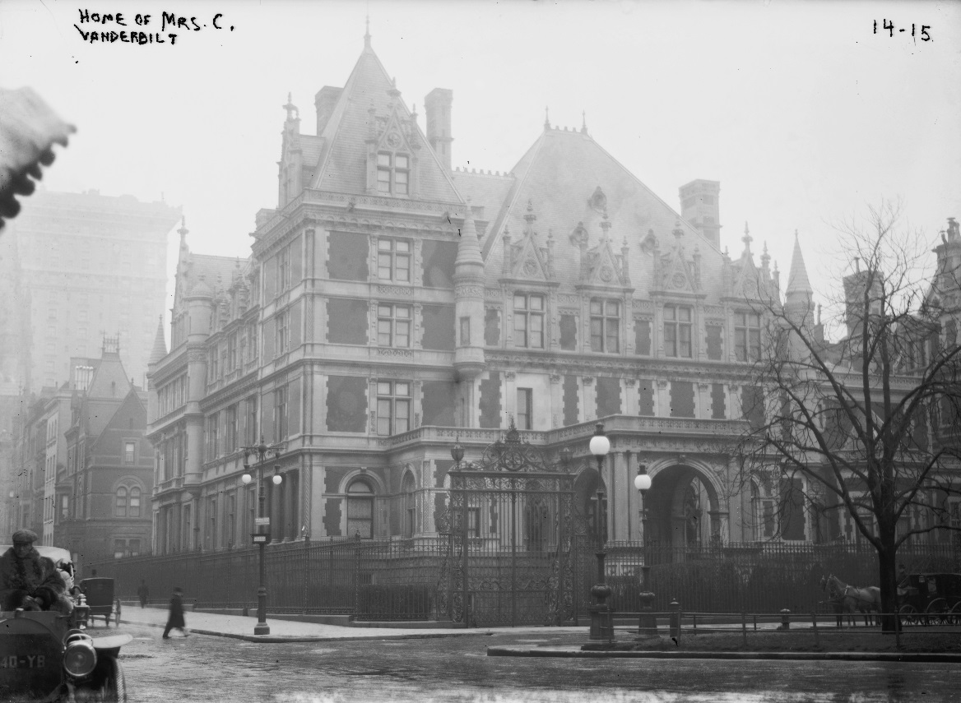
Gilded Age ( 1865 – 1898)
Gilded Age -Period when corruption existed in society but was overshadowed by the wealth of the period (“gilded” is when something is golden/beautiful on the surface but is really cheap/worthless underneath
Abuses in business and government caused problems for immigrants, laborers, and farmers
Term comes from a book written about the time period by Mark Twain and Charles Dudley Warner in 1873 The Gilded Age
View Intro to America’s Industrial Revolution

Slide 4
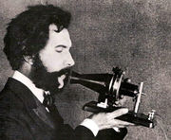
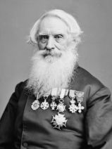
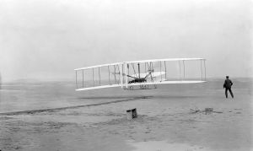
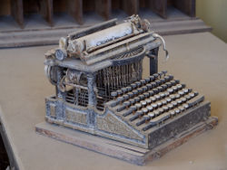
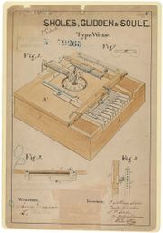
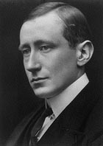
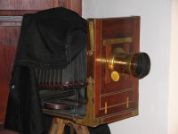
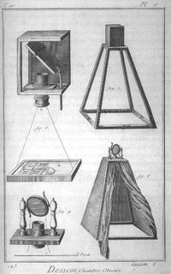
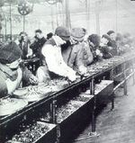
Industrialization:
Thomas Edison
Perfected the light bulb in 1880, and motion picture
Organized power plants
Established first research lab
Alexander Graham Bell
Telephone (1876)
Henry Ford
Assembly Line
George Eastman
Camera (1885)
Samuel Morse
Telegraph (1837)
Wright Brothers
Airplane (1903)
Christopher Sholes
Typewriter (1867)
Guglielmo Marconi
Radio
Samuel Morse
2nd Phase of Industrialization
FAST!
By 1900 we were the #1 Manufacturing Power
**Need a Cheap labor Source
Rural → Urban
Alexander Graham Bell
Wright Brothers on 1903 Flight
19th Century Typewriter
Marconi
19th Century Camera

Slide 5
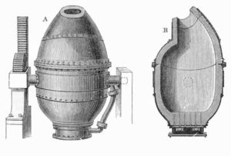
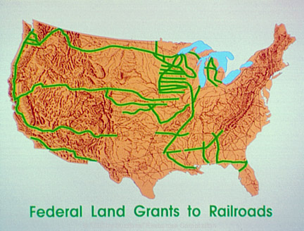
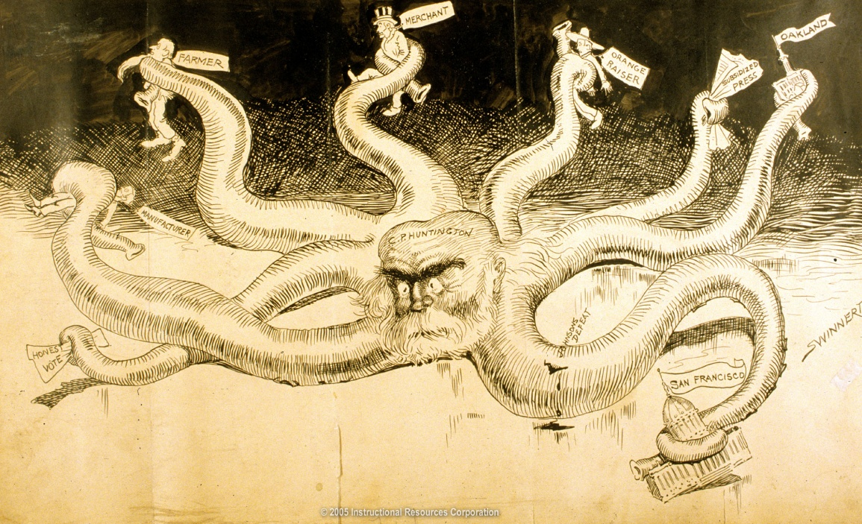
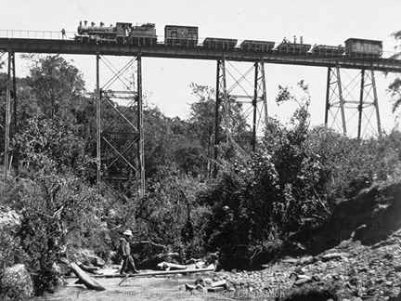
Industrialization: The Steel & Railroad
Bessemer Process
Steel is used in railroads, farm equipment, canned goods, sky scrapers, Bridges
Railroad Benefits
Stimulated growth of other industries (steel, iron, coal, lumber, glass)
Helped cities grow
Helped increase westward expansion of America
Standard time zones were created to get everyone on correct time
Railroad Corruption
Charged much higher rates to western farmers
Credit Mobilier Scandal 1868

Slide 6
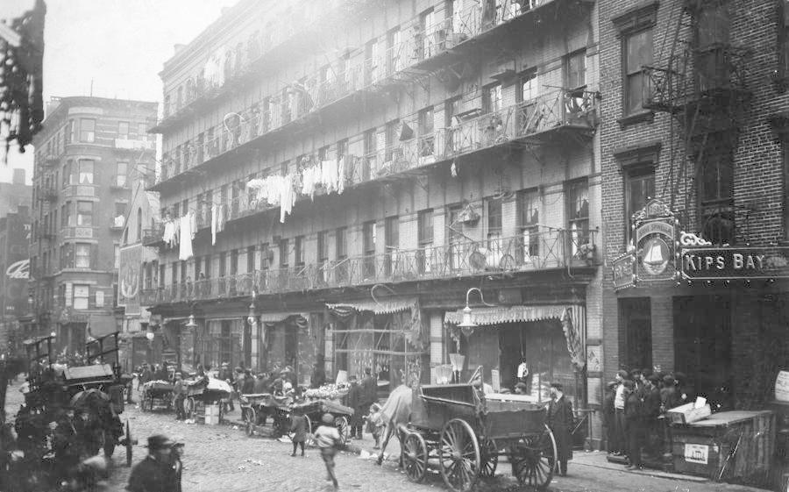
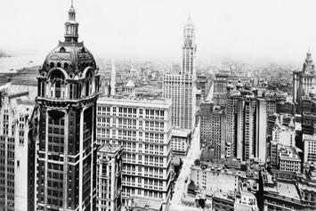
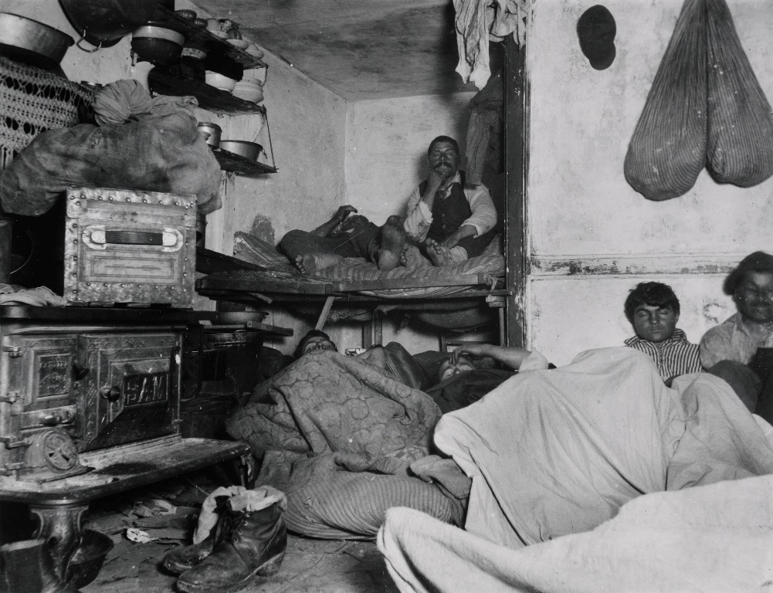
Industrialization → Urbanization
Urbanization- growth of cities
Vertical
Transportation
Crowded
Fast Paced
3 reasons cities grew in late 1800’s and early 1900’s
New immigrants arrived in cities for work
As farm machines replaced farmers they moved to cities
African Americans left South after Civil War and came to Northern cities.

Slide 7
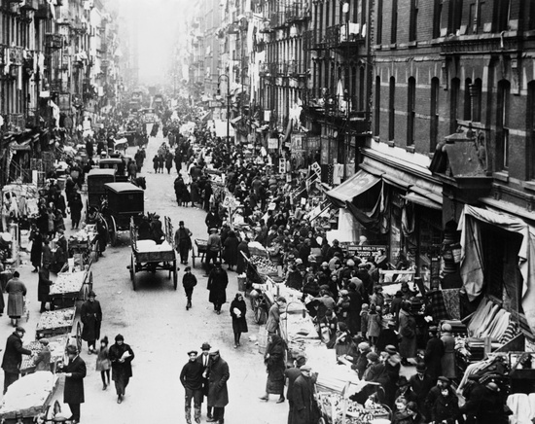
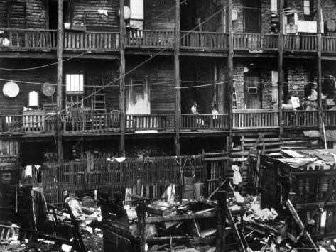
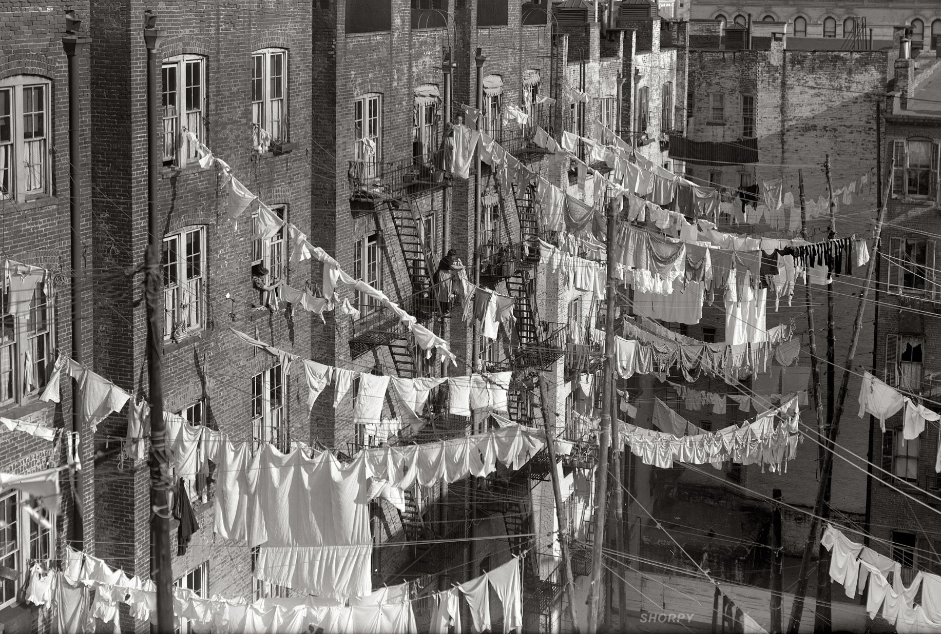
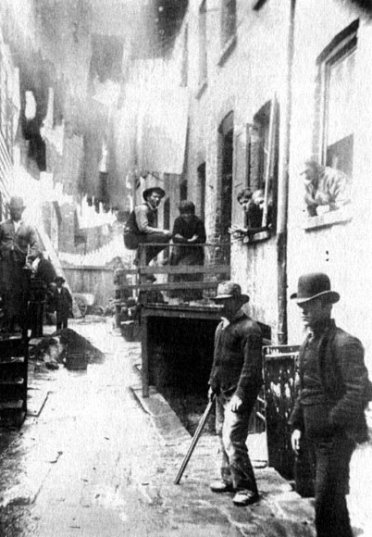
Problems in Cities
1. Housing shortages- Tenement
2. Transportation
3. Clean water
4. Waste and garbage
5. Fires
6. Crime

Slide 8
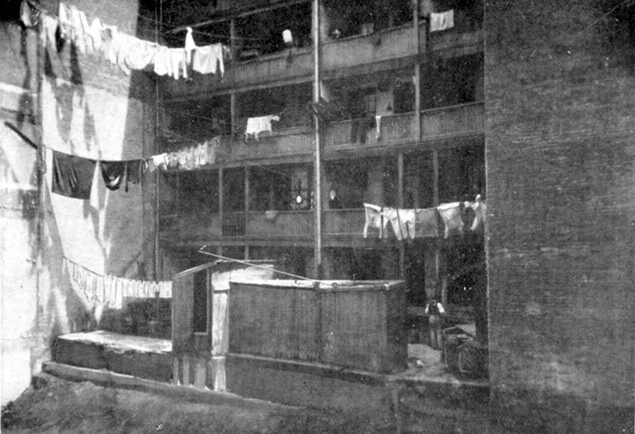
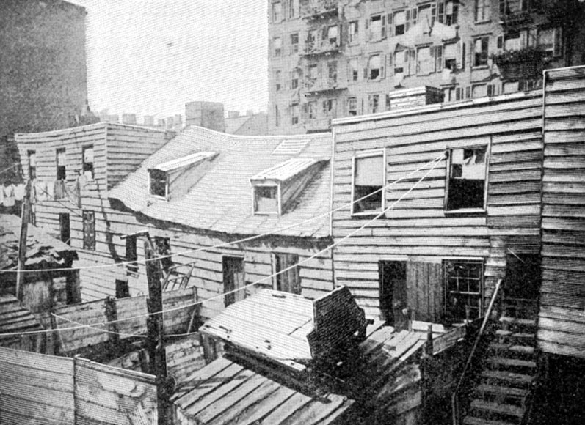

Slide 10
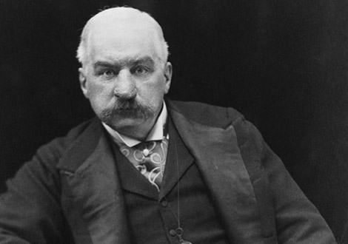
The Rise of Big Business
Andrew Carnegie
Steel
John D. Rockefeller
U.S. Standard Oil
J.P. Morgan
Banker

Slide 11
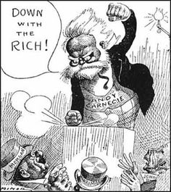
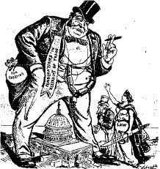
The Rise of Big Business
Trusts -A group of separate companies placed under the control of a single managing board
Monopoly - complete control of a product or service
Social Darwinism
Laissez-Faire
“Captains of Industry”
“Robber Barons”

Slide 12
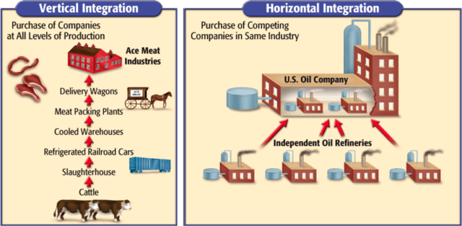
The Rise of Big Business
Vertical Integration
A process in which a company buys out all of the suppliers. (Ex. coal and iron mines, ore freighters, RR lines)
Horizontal Consolidation
-A process in which a company buys out or merges with all competing companies (JP Morgan bought out Carnegie steel and other companies)

Slide 13
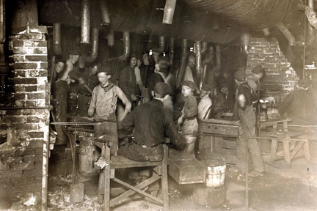
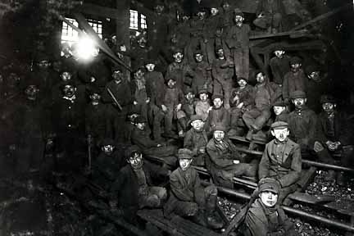
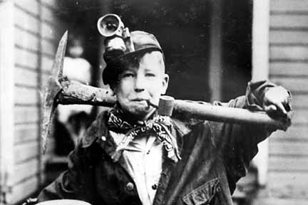
Poor Working Conditions in the Late 1800’s
Three Things to Work Out:
Better Pay
Better Working Conditions
Shorter Workday

Slide 14
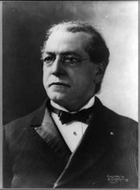
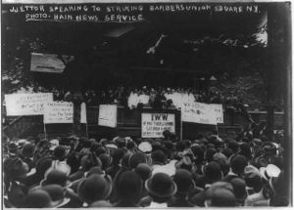
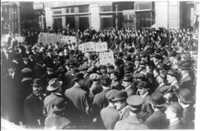
The Rise of Labor Unions
The Purpose of a labor union was “strength in numbers.” Attempted to gain better working conditions and pay. "bread and butter" issues of wages, benefits, and work rules
The Knights of Labor
The American Federation of Labor (AFL)
Industrial Workers of the World (IWW) or Wobblies (Socialism)

Slide 15
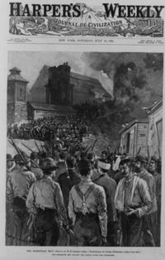
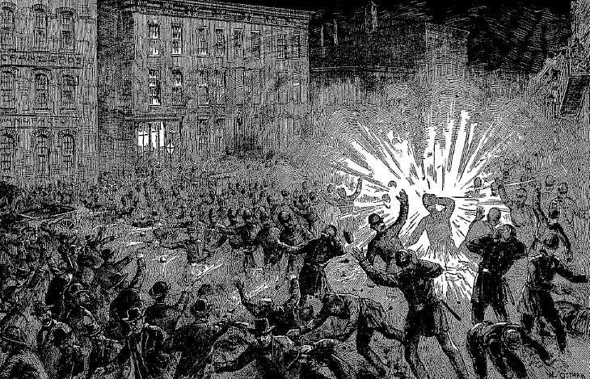
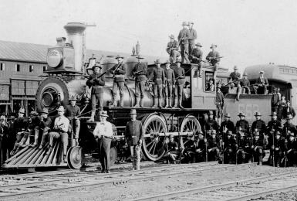
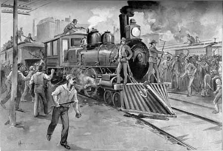
Setbacks for Labor Unions
Inherent Divisions
Not focusing on “Bread and Butter”
Pushback from Businesses
Great Railroad Strike of 1877
Protest wage cuts (Scabs)
Haymarket Riot 1886
Violent Result (Bombs)
Homestead Strike-1892
Carnegie Steel (Pinkertons)
Pullman Strike 1894
Railroad

Slide 16
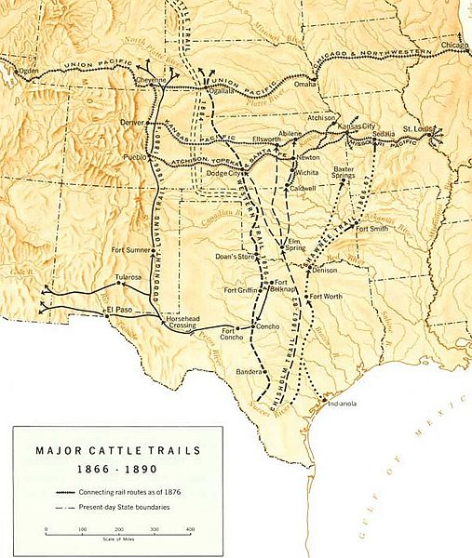
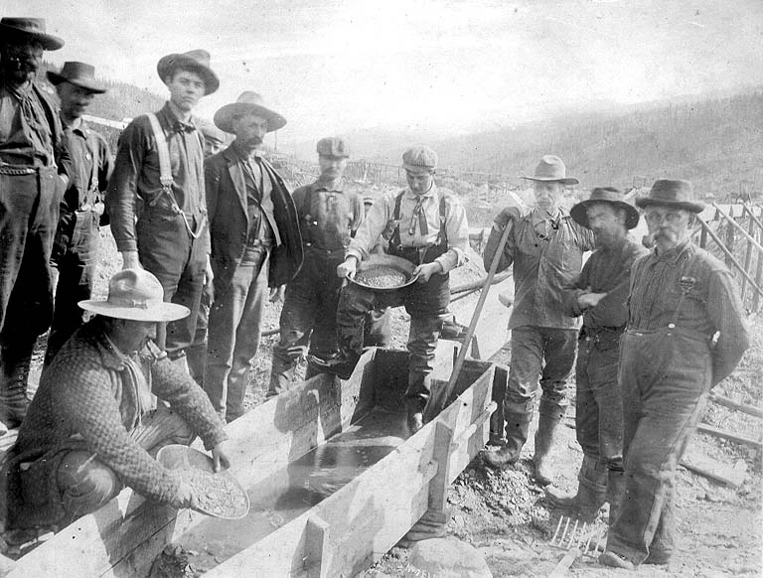
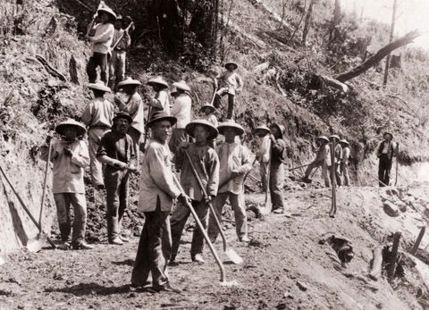
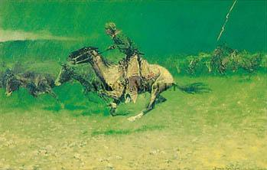
Westward Expansion: Manifest Destiny Part II (?)
Romanticized time period (Cowboys & Indians)
New Markets/Resources
Railroad (Transcontinental Railroad – 1869)
Mining
1890 Census = Frontier Settled and Closed

Slide 17
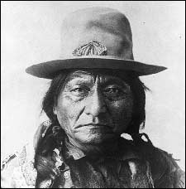
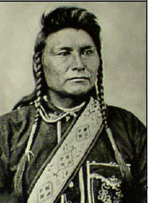
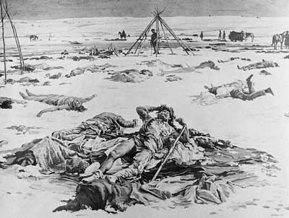
Westward Expansion: Indians
By the end of the Civil War, all surviving Native Americans were living on the Plains and in the West.
By 1900, virtually all were forced onto reservations
Indian Wars
Sand Creek Massacre
Battle of Little Bighorn
Wounded Knee
Ghost Dance War
1860 – 13 million buffalo → 1900 – ~1000 left
1881 – Helen Hunt Jackson’s A Century of Dishonor
Criminal Code of 1884 (Assimilation)
Dawes Severalty Act (1887)

Slide 18
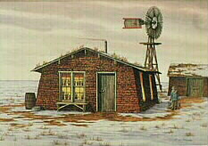
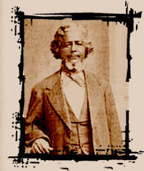
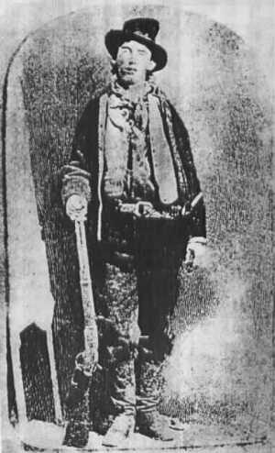
Plight of Farmers
Homestead Act 1862: Free Land… IF….
21 years-old and head of family
Any U.S. citizen or immigrant that filed
$10.00 fee
Build house/ 6 Mo./Yr. a resident
Farm plot for 5 years
Difficult to Farm…
Exodusters (African American Farmers)

Slide 19
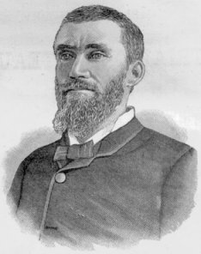
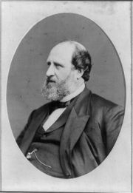
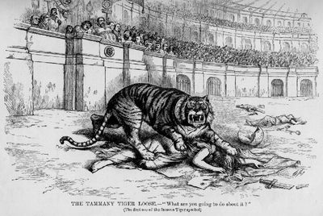
Corruption in Government
Some existed at the Federal or state level, but mostly at the municipal level (City)
Political Machines
Rig Elections
Boss Tweed (Tammany Hall)
Spoils System/Patronage
James Garfield
Charles Guiteau

Slide 20
Corruption in Big Business
Attempts to expand business (Sometimes by illegal means)
Trusts
Monopolies

Slide 21
4 Major Social Issues
Political Issues
Economic Issues
Social Issues
Regional Issues

Slide 22
Political & Economic Issues

Slide 23
Currency Issue & the Gold Standard (Eco.)
The question becomes how are we going to back the money within the United States?
1873: Gold Standard (The amount of $ in circulation was limited by the amount of gold held in the treasury.)
Caused a decrease in the amount of money in circulation
Lowered prices (bad for farmers trying to sell crops)
BIMETALISM
Strict vs. Limited = (Gold) vs (Silver & Gold)
32oz Silver = 1oz Gold
**At the Root of the Question is Inflation/Deflation

Slide 24
Money Question
Gold & Silver Money “Bimetallism” – Farmers, Debtors, and start-up Businesses
Borrow money at lower interest rates
Pay off their loans more easily
Just Gold “Gold Standard” – Bankers, Creditors, Investors, and established Businesses
Dollars backed by gold would hold their value against inflation
As the U.S. economy and population grew faster than the number of gold-backed dollars, each dollar would gain in value.
1865-1895 = $ increased in value by as much as 300%

Slide 25
Tariffs (Eco.)
After the Civil War, Congress raised tariffs to protect new US industries.
Big business wanted to continue this; consumers did not.
Tariffs raise prices on consumer goods
1885 → tariffs earned the US $100 mil. in surplus! (more than ½ fed. Revenue)
Other countries also started placing taxes on US Farm Products & this hurt overseas sales
From Farmers P.O.V- Industry is getting rich at the expense of rural America

Slide 26
Civil Service Reform (Polit.)
Attempted to end Patronage/Spoils System → Public outrage over Garfield assassination
1. Creating the Civil Service Commission which required appointed govt. officials to pass the Civil Service Exam to base jobs on merit instead of friendship
2. Federal employees did not have to contribute to campaign funds
3. Federal employees could not be fired for political reasons
At first it only applied to 10% of federal employees, but later was expanded to most federal jobs

Slide 27
Laissez-faire vs. Socialism Debate (Polit.)
Laissez-Faire: a policy or attitude of letting things take their own course, without interfering. Abstention by governments from interfering in the workings of the free market.
Socialism: a political and economic theory of social organization that advocates that the means of production, distribution, and exchange should be owned or regulated by the government
Debate over the size and role of the Government
Debate over government regulation of the Economy
Laissez-Faire tradition but increasingly in Gilded Age a Push to regulate business

Slide 28
Social Issues
**These issues do not begin or end during this era… they just evolve

Slide 29
Women:
Antebellum Reform Movements: Temperance, Prison Reform, Abolitionism, Women’s Rights, Education
Early 19th c Women
Unable to vote.
Legal status of a minor.
Single → could own her own property.
Married → no control over her property or her children.
Could not initiate divorce.
Couldn’t make wills, sign a contract, or bring suit in court without her husband’s permission.
Cult of Domesticity = Slavery
2nd Great Awakening inspires women to improve society
The Abolition Movement
In 1840s there’s a split in the abolitionist mvt. Over women’s role in it
The 15th Amendment (Caused a split)
National Woman’s Suffrage Association – Susan B. Anthony & Elizabeth Cady Stanton [Refused to support]
American Woman’s Suffrage Association – Lucy Stone [supported]
Minor v. Hapersett (1875)
By 1910 women had the right to vote in Wyoming, Utah, Idaho, Colorado, and Washington.
**Women become more active in the late 1800s in spite of societal limitations

Slide 30
African Americans:
13th, 14th 15th Amendments should have resolve the issues of African Americans but… Jim Crow creating a system of legal racial segregation in public and private facilities
Lynchings
White Supremacy
Barred from certain stores, restrooms, ect.

Slide 31
Immigrants:
New Immigrants
Old Immigrants
new” immigrants of Gilded Age were from Southern & Eastern Europe.
didn’t speak English
tended to congregate in cities in ethnic communities
not protestant
associated with countries that had history of non-democratic rulers
Italians, Polish, and Eastern European Jews
They were from Northern and Western Europe
mainly white, English speaking protestants
lots went to cities (especially Irish) but many went to country to farm – less visible
“The term Old Immigrant refers to someone who came to the United States from Northern or Western Europe (i.e. Britain, France, Germany or Scandinavia)”
England, Scotland, Sweden, Germany, Ireland, China, Japan and Mexico.
**Faced a lot of discrimination… Not WASPS

Slide 32
Ellis Island
It is located at the mouth of the Hudson River in New York Harbor.
Ellis Island was the location of the main entry facility for European immigrants entering the United States
An estimated 17 million immigrants passed through its noisy bustling facilities

Slide 33
Angel Island
Located in San Francisco Bay
The Immigration Station on the northeast corner of the island processed approximately one million Asian immigrants (primarily Chinese)
Between 1910 & 1940 about 50,000 Chinese immigrants entered the US through Angel Island

Slide 34
Regional Issues
North, South, West

Slide 35
The North
Rapidly Urbanizing, Industrializing
Became a lot wealthier
Cities were Booming due to Immigration, Urbanization, & Industrialization
Diversity

Slide 36
The South
Stuck in Time
Remains a 3rd world country till the 1940s
White Supremacy returns
Lack of diversity (Economically & Culturally)

Slide 37
The West
Closing of the Frontier
Final Clash between Natives and US government
Mining Towns
Cowboys (Long Drives)
Romantic Image of west (Life was actually really miserable)

Slide 38
Robber Baron or Captain of Industry?
Robber Baron
late-nineteenth-century industrialists, especially those who ostentatiously displayed their wealth
Wealthy manipulator of Government, paying corrupt officials to enact laws the support business= congress- tariffs
Squeezing out competition unfairly-creating monopolies and then enacting unfair rates or prices on consumers (RR-farmers)
Exploiters of the working class- who pay the workers as little as possible and reap huge profits
Captain of Industry
Or “Industrial Statesman”
Capitalist leaders helped the country more
They deserve the riches they create
They provide progress, jobs
Drive technology
Deserve the riches they create
"Millionaires are the bees that make the most honey and contribute most to the hive even after they have gorged themselves full."--Andrew Carnegie

Slide 39
1876-1890’s 6 Pres 4 were Republicans
Hayes- (Repub) 1876- disputed election Secret Deal, ie., Reconstruction Compromise of 1876, did not run again in 1880.
Garfield (Repub) 1881, Assassinated by Guiteau, Office Seeker,
Arthur- VP under Garfield, allegations of corruption earlier in career, supported Civil Service Reform, not nominated for the next election
Cleveland (Dem) close election against corrupt Blaine (Repub), lots of Mudslinging, adultery… pro-capitalist, low tarriff
Harrison- (Repub) 1888, close election, pro-tariff and big business
Cleveland (Dem) 1892- Runs and wins again
McKinley (Repub) 1896- Extremely pro business, pro- gold standard- will advocate strong laissez faire attitude in government, supported by the supreme court

