Slide 1
Development of international trade
600 BCE – 600 CE
Page 21 of your notebook

Slide 2
Rome
Sassanid/Persian
Han China

Slide 3
The Basics
Development of classical empires = increased connections between peoples
Involved the transfer of technologies and religions between regions

Slide 4
Group Discussion Break:
What would one unintended consequence of trade be? (30 secs)
DISEASE!

Slide 5
Factors of Trade
Geography
Determined what goods, where, and who exchanged
Climates
determines:
Where valuable resources found
Types of plants grown
Where seaports, mountain passes, and oases are located

Slide 6
Why Trade occurs
Trade happens because people want goods
Example: Salt—used to preserve food before refrigeration
Merchants willing to make difficult journeys in hopes of making a nice profit
Afro-Eurasian network = web
Wealthy Romans buy silk made in China → merchants transport silk and other goods for a couple hundred miles → hand off goods to next caravan and get paid → head back home to repeat the process
Silk, tea, spices, salt relayed from town to town until it reached its final destination

Slide 7
The silk roads

Slide 8
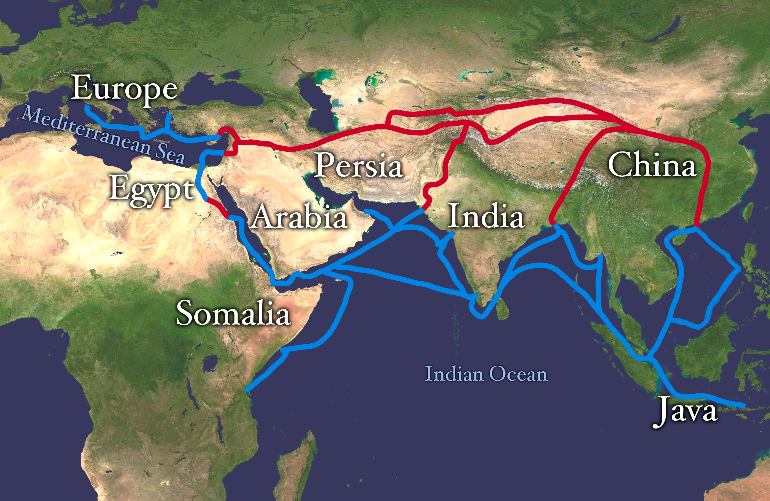
Routes of the Silk Road (Red)

Slide 10
The Silk Road
Most extensive of the land-based trade routes in the world
Named because of the highly valued silk traded
Other items:
Horses, spices, furs, ivories, tea, porcelain (china), cotton, rice, camels, glass, gold, fur cattle, olive oil, perfumes
Exchange of grains and fabrics across Eurasia = changed farming techniques crops in new regions
Qanat system—form of irrigation, transports water from below ground to the surface in arid regions
Merchants and missionaries from S. Asia introduced Buddhism
Han empire in decline—many people converted
Disease such as the bubonic plague frequently crosses the Afro-Eurasia routes

Slide 11
Sahara Caravan Routes

Slide 12
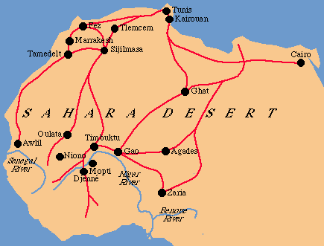
Trans-Saharan Routes

Slide 13
Political Map of Africa

Slide 14
Trans-Saharan Routes
Commerce across North Africa
Introduction of the camel
Means of transporting goods
Major increase in trade
600-1450, Islam was carried into the Trans-Saharan region along the trade routes
North-South Eurasian Routes
Connected the Baltic Sea and the Black Sea
Constantinople (Byzantine capital) was a crossroads that linked exchange routes together

Slide 15
Sea networks
Africa, Europe, and Asia

Slide 16
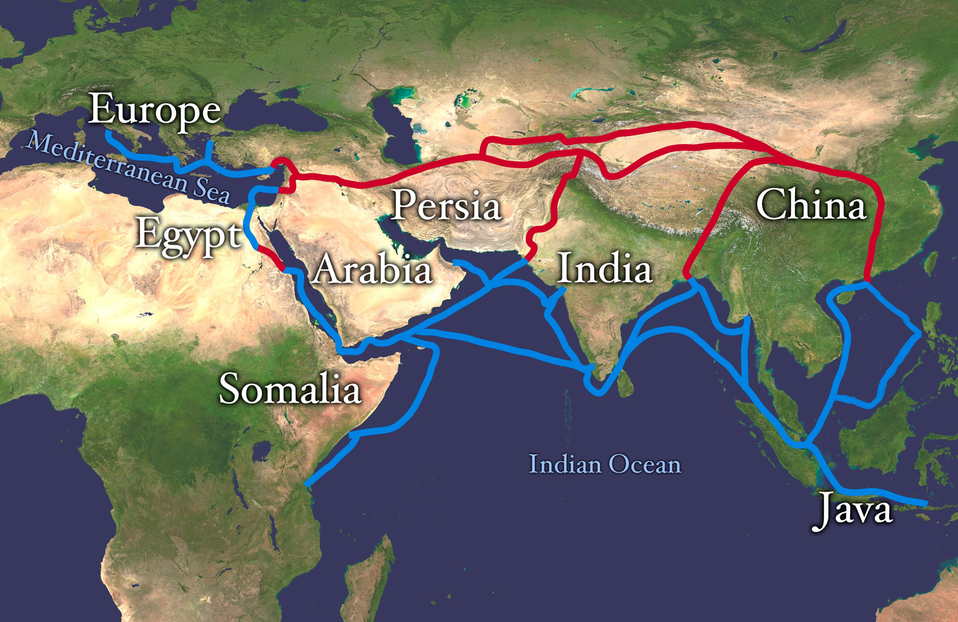
Indian Ocean Trading Network (Blue)

Slide 17
Political Map of Indian Ocean

Slide 18
Indian Ocean Trading Network
Largest sea trading area in the world until 1400s
Connected SE Asia and China to Africa, the Middle East, and S. Asia
Major conveyor of Buddhism from S. Asia into East and SE Asia
Muslim merchants/missionaries spread Islam from the Middle East to S. Asia and East and SE Asia
Similar items on the land routes carried on the sea routes

Slide 19
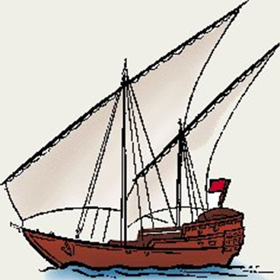
Indian Ocean Trading Network
Sea trade depended on ocean currents and wind
Natural clock helped merchants plan timing and content of shipments
Arab shipbuilding and navigational skills spread quickly
DHOWS—small seaworthy Arab ships using a triangular lateen sail

Slide 20
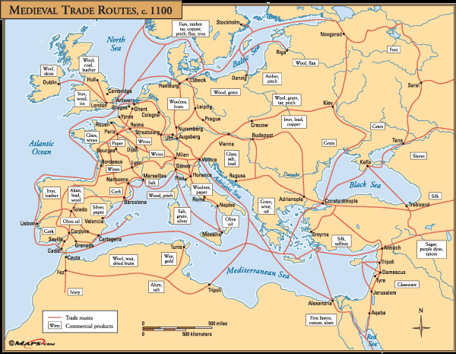
Med. Sea and Black Sea Networks

Slide 21
Political Map of Europe

Slide 22
Mediterranean Trading Areas
Started by Egyptians and Phoenicians—continued by Greeks, Romans, and Byzantines,
the trade network in the Mediterranean was vast and long-lasting
Traded: olives, pottery, glass, woodwork, leather, wool textiles
Merchants traded gold, ivory, salt, copper, and slaves
Christianity was carried to east/west Europe and Africa on foot by missionaries and merchants

Slide 23
black Sea Trading Areas
The Black Sea also important as it coastlines on Europe and Asia
Constantinople one of the largest ports of exchange
Merchants carried goods from the Silk Roads, the Mediterranean and Russia
600-1450 merchants unwittingly carried the bubonic plague into western Europe

