Slide 1
Great Depression
&
WWII

Slide 2
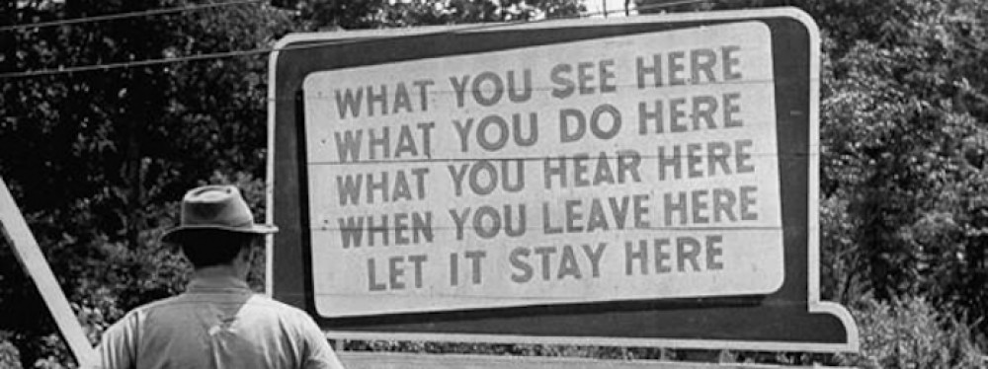
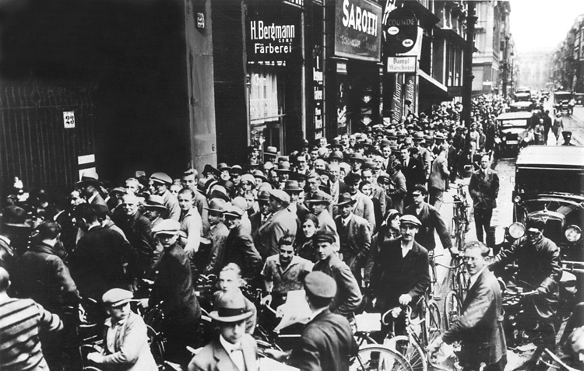
Economic Instability and the Great Depression
1920’s generally seen as a time of prosperity but economic instability characterized the era
  Recovery post WWI was fragile
  Stock market crash in 1929 sparked a deep economic depression
  1930’s: industrial production shrank, world trade dropped, unemployment rose

Slide 3
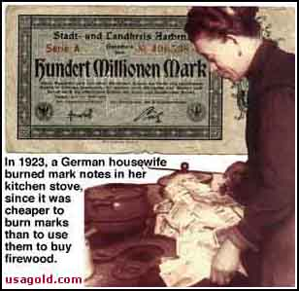
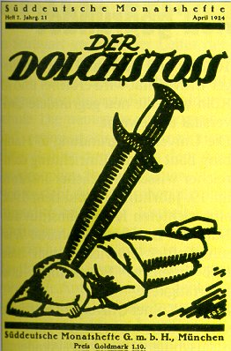
Economic Impact on Germany
1919 - Germans created a democratic government = Weimar Republic
The republic was:
  politically weak
  criticized by both the left and right for the results of the Treaty of Versailles
  right-wing the claim that the Army had been 'stabbed in the back' by the government
Germany fell behind in reparations payments, and printed huge quantities of paper money, setting off out-of-control inflation

Slide 4
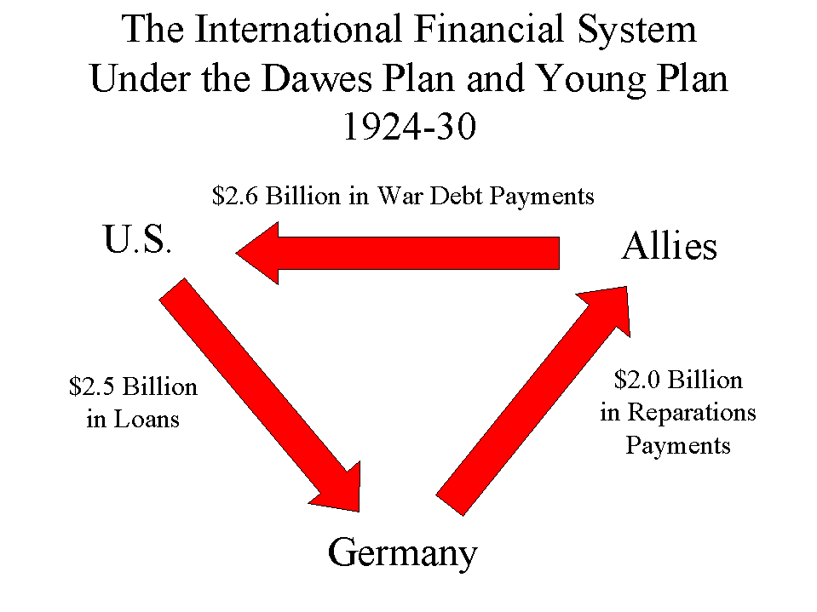
Economic Impact on Germany
1924 - the Dawes Plan
  reduced payments
  France withdrew from the Ruhr
  loans helped the German economy recover

Slide 5
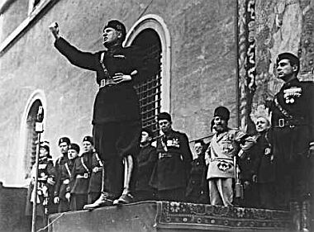
Economic Impacts on Italy
1919 - Italians outraged by the Paris Peace treaties
  disorder and chaos broke out as Italy faced
  economic hard times
  trade declined
  taxes rose
  WWI veterans faced unemployment
  government seemed powerless to end the crisis
Benito Mussolini organized veterans and other discontented Italians into the Fascist party

Slide 6
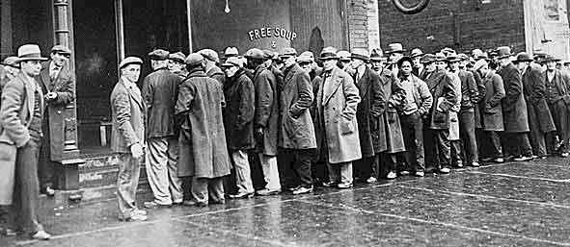
Economic Problems of the 1920s (cont)
US pulled back on investments in mid-1928 – lack of capital caused repayment structure to collapse
France and Britain faced economic problems
  France lost 1.5 million people in the war
Britain’s economic health slipped before the war
  Mines and factories out-producing consumption
  Merchant marine couldn’t hold the links of the empire together

Slide 7
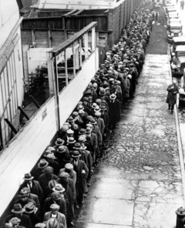
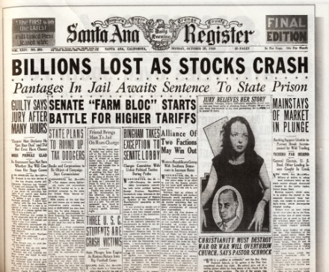
Economic Problems of the 1920s (cont)
US took over as financial center of the world
  As Britain declined, capital invested by Britain supplied by US
  British production fell further; unemployment rates high
US doing well in 1920’s; little damage and fewer casualties
  Became prime creditor nation; others dependent on US
When stock market faltered – triggered worldwide depression

Slide 8
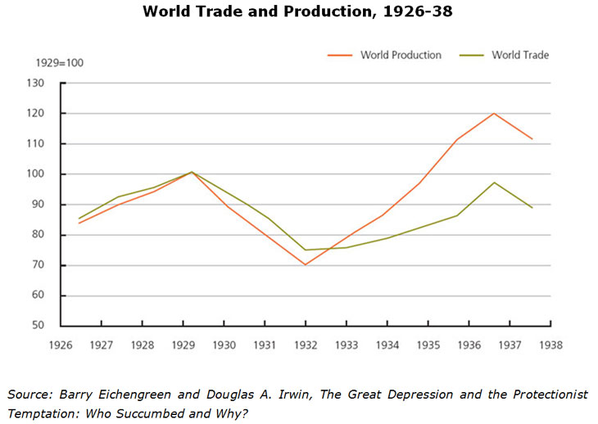
Economic Problems of the 1920s (cont)
As imperialist nations experienced setbacks, colonies suffered
  Production on plantations had increased – no market for their products – colonial peoples had no means to purchase manufactured goods
Western nations turned to protectionism

Slide 9
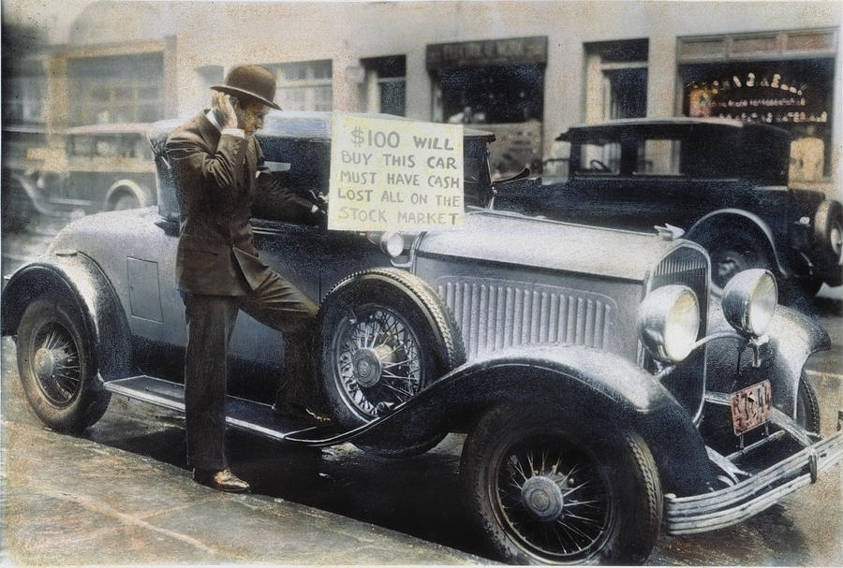
The New York Stock Market Crash and the
“Great Depression”
Depressed state of agriculture resulting from the war an issue
  Farmers in US, Canada, Argentina, and Australia had expanded production during WWI
  European farmers went back to work after war
  Food surpluses triggered falling prices
  Farm families couldn’t purchase manufactured goods leading to a surplus
In US people speculating on stocks
  Damaging behavior - people buying stock on margin
  People borrowed heavily and when stock prices stumbles, brokers called in loans
  Stock market crashed, banks collapsed, people lost their investments, and economic crisis spread

Slide 10
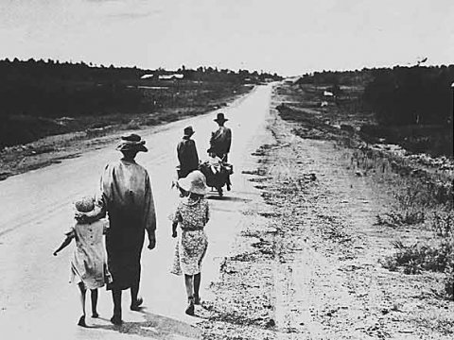
The New York Stock Market Crash and the “Great Depression” (cont)
US began to call back loans to Europe
  Led to key bank failures in Austria and Germany
  Infrastructure built on repayment caved
  Crisis expanded to every sector of industrial society and their colonies
US placed high tariffs on goods; other countries couldn’t export
  Japanese economy very dependent on US;
  highly affected

Slide 11
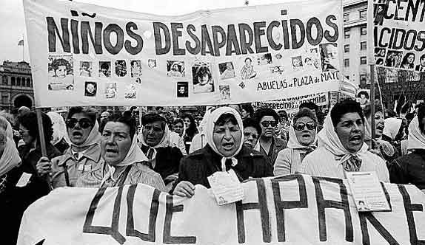
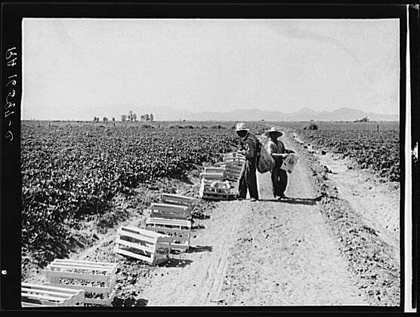
The New York Stock Market Crash and the “Great Depression” (cont)
Primary producing economies usually dependent upon the export of one product
  When the market disappeared, little to fall back on
Latin American countries saw unemployment rates rise rapidly
Imperialist colonies in Africa continued to trade with mother countries

Slide 12
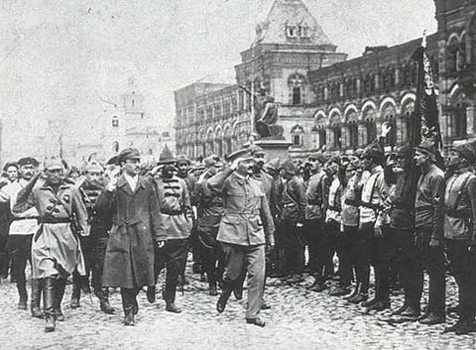
The New York Stock Market Crash and the “Great Depression” (cont)
Countries not dependent on foreign trade felt less of the effects of the depression
  Russia: industrial production increased steadily
  China: large agriculture based economy was protected; its markets were domestic
Many governments reacted by practicing economic nationalism; high tariffs, import quotas and prohibition provoking retaliation from others.

Slide 13
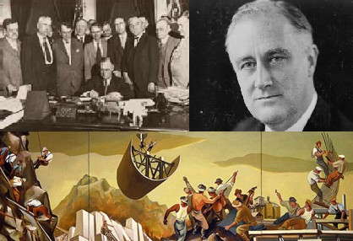
Political Reactions to Economic Woes
  Great Depression challenged traditional capitalism/“laissez faire” economics and FDR turned to John Maynard Keynes
    Government should do the spending
      New Deal programs
        Massive government spending

Slide 14
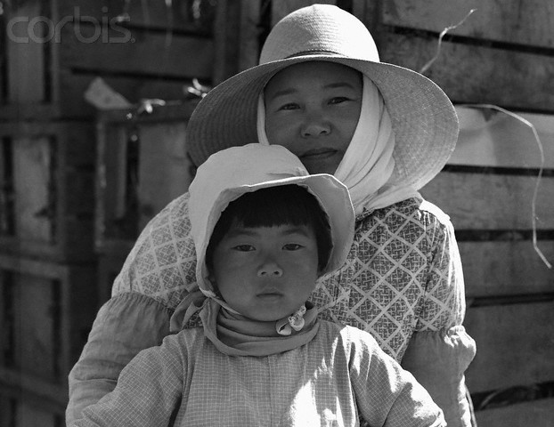
Political Reactions to Economic Woes
Japan: passive at first, then Japan’s govt intervened forcefully
  Programs to build public works
    Incentives and subsidies
    Devaluation of the currency
    Wage control
  These measures stimulated the economy
Germany: Hitler intervened aggressively
  Large public works projects

Slide 15
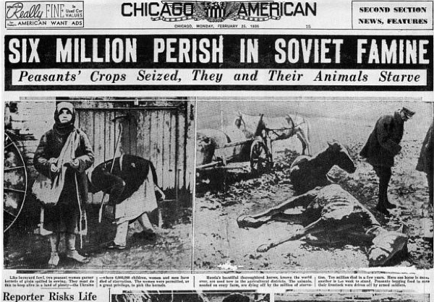
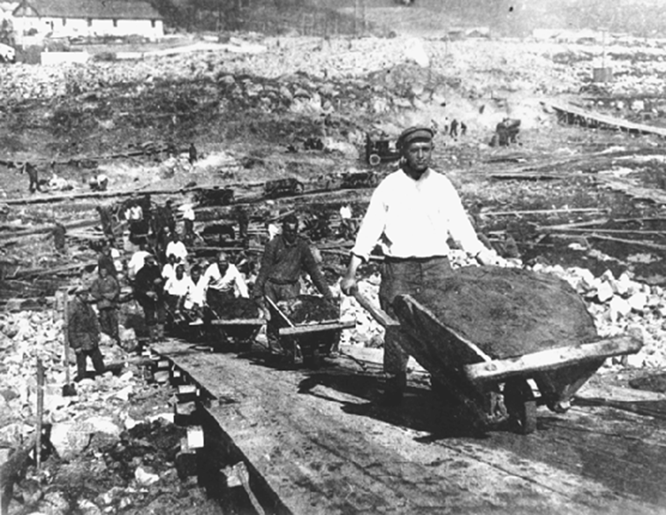
The Rise of Fascism
Soviet people endured the repressive, terrorist tactics of Stalin’s govt
  Govt collectivized agriculture; consolidated small farms into commonly owned fields
    Kulaks, prosperous peasants, could lose their farms and opposed collectivization
      Kulaks slaughtered their livestock rather and give in to govt
  Stalin order the liquidation of the kulaks
    Millions arrested or sent to labor camps and executed
      Stalin's secret police force the NKVD
      (Narodny komissariat vnutrennikh del
      People's Commissariat of Internal Affairs)
      took care of any further resistance
        Millions sent to death or to gulags

Slide 16

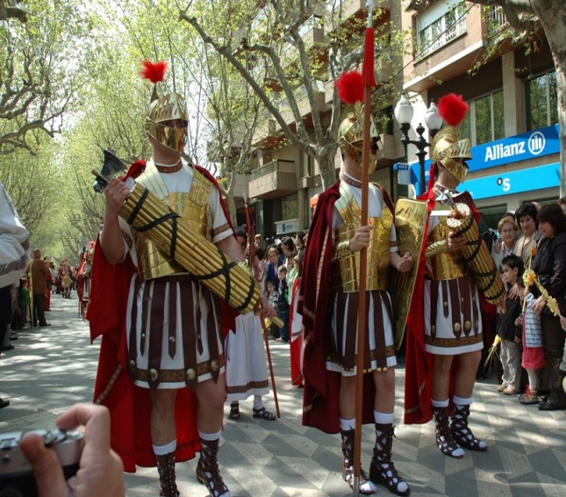
The Rise of Fascism (cont)
Changes in Russia frightened Europeans/Americans
  Fear that the communist elements would take over other countries
Great Depression and uncertainty -communism and the apparent collapse of the free market – made many turn to fascism
  Extreme form of nationalism
  Subordinate your will to the state
    Promised full employment
    Stop communism
    Conquer new territory
Condemned communism for abolishing private property but used totalitarian tactics along with a powerful secret police
Ancient Roman symbol of power

Slide 17
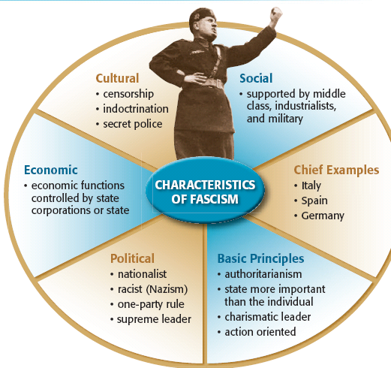

Slide 18
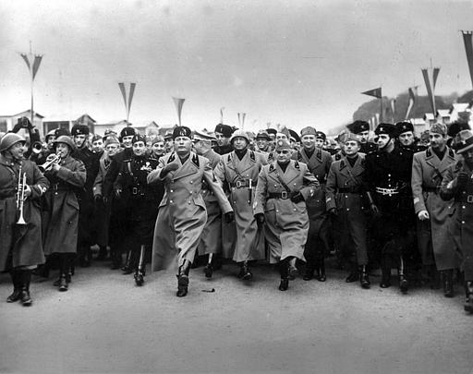
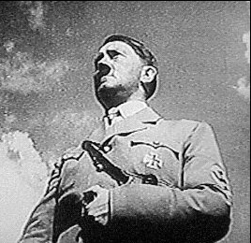
The Rise of Fascism (cont)
Mussolini gained control 1922; established a one-party dictatorship
1930’s – fascist movements across Europe, Americas, China, Japan
  People feared rapid change and economic insecurity; placed hopes in charismatic leaders and their promises
Most notorious – Nazi Party and Adolf Hitler

Slide 19
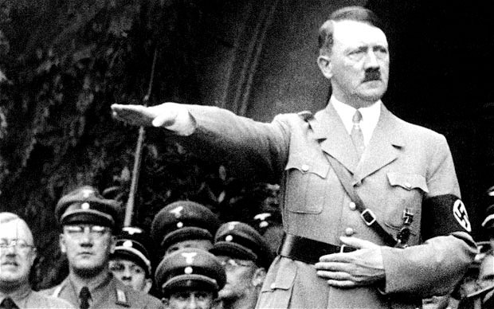
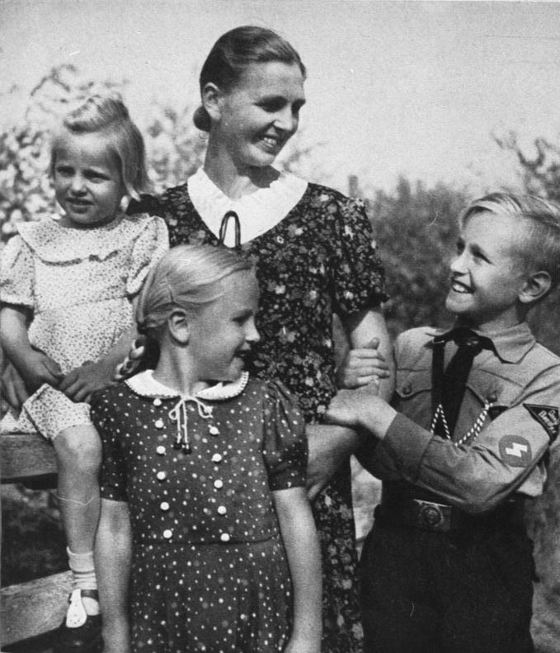
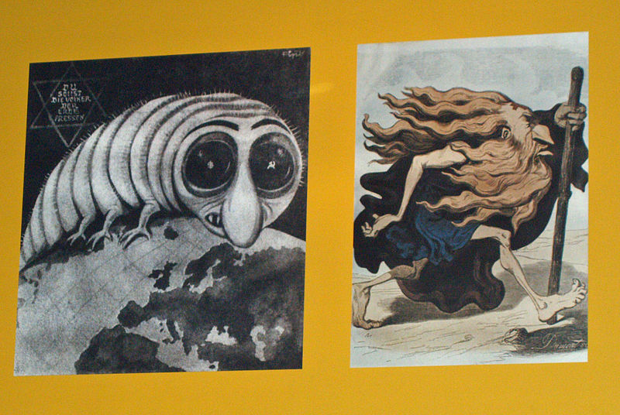
The Rise of Fascism (cont)
Nazi leaders wanted to reverse Germany’s humiliating defeat
  Hitler abolished Weimar Republic
  Expanded arms production
  Created new jobs
  Germans racially superior; Aryans
Nazism appealed to lower-middle class who had lost almost everything
  Subject will to govt to achieve greatness
  Rigid hierarchy reinforced traditional roles of women
    Launched campaign to increase birth rates; birth control ended – awards for large families
Discriminated against Jews
  No inter-marriage; lost jobs and businesses
1938 thousands of Jewish stores, synagogues destroyed and 100+ murdered – many left Germany

Slide 20
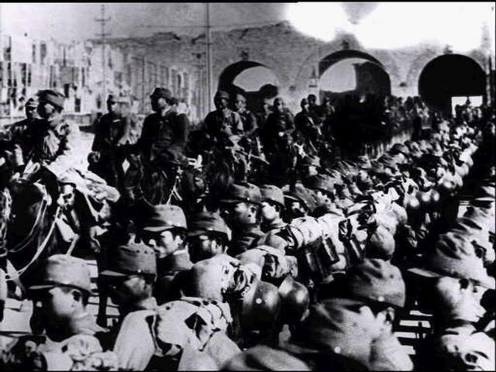
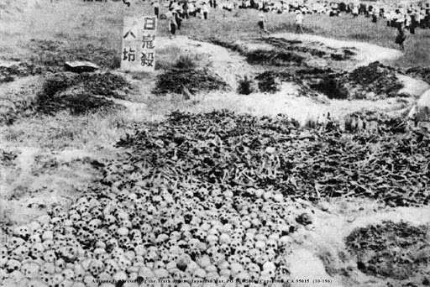
The Rise of Fascism (cont)
Japan
  More authoritarian
  Worked to stave off effects of Great Depression
  Military group advocated a defense state
    Marched into Manchuria
      Killed prime minister
1937 Japan aggressively attacking other areas of Asia
  The Nanking Massacre
    Japanese invaded Chinese capital
    Brutal mass killings
    Systematic arson, torture, and rape
      Nanking Safety Zone
        American and European residents created in center of city as a refuge

Slide 21
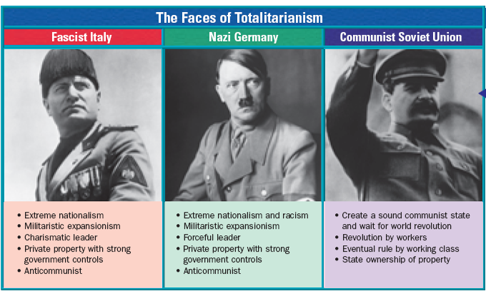

Slide 22
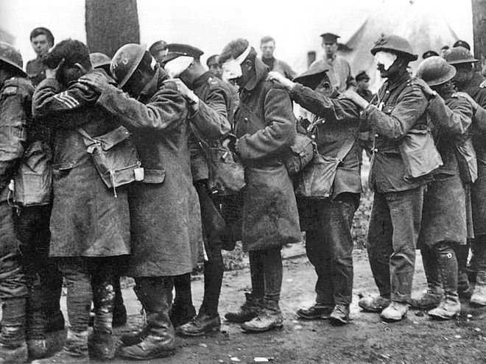
World War II
Tensions of WWI never fully resolved
  1931 Japanese expansion into Manchuria sparked conflicts
  Fascist movements in Europe encouraged military aggression
    1936 Germans move into the Rhineland
  1936 Germany withdrew from the League of Nations
  1936 Mussolini attacked Ethiopia
  1936-1939 Fascism gained support in Spain and triggered a civil war

Slide 23
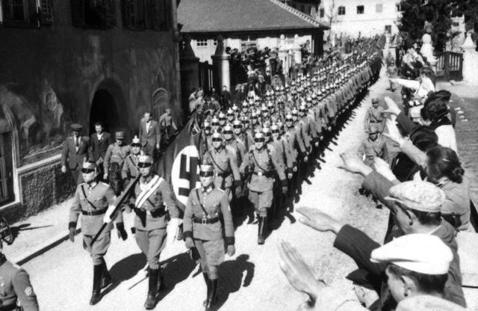
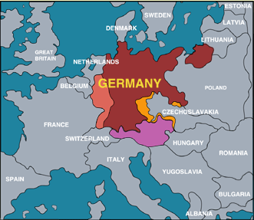
The Onset of War
1938 (March) Anschluss—annexation of Austria
1938 (March) Hitler invaded Sudetenland
  Munich Conference had weak response and agreed on appeasement policy
  Hitler kept going and captured Czechoslovakia
    Britain and France declared war on Germany
Germany and Italy in Rome-Berlin axis; rest of Europe would revolve around this central pact
1939 (August) Soviet Non-Aggression Pact signed
1939 (September) Germany invades Poland

Slide 24
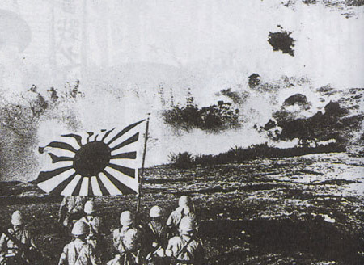
The Onset of War (cont)
Japan and China already engaged in fighting when war in Europe began
  Japan began attacking other areas in Asia when war in Europe broke out
1940 – Germany, Italy, Japan signed Tripartite Pact; strongest of the Axis Powers
  Spreads the war into two major theatres;
  Pacific and Europe
In WWI there were distinct fronts, much broader in WWII
Britain and France still feeling effects of WWI, had to build defenses
  Took until 1942 and 1943 to stop early German and Japanese successes

Slide 25
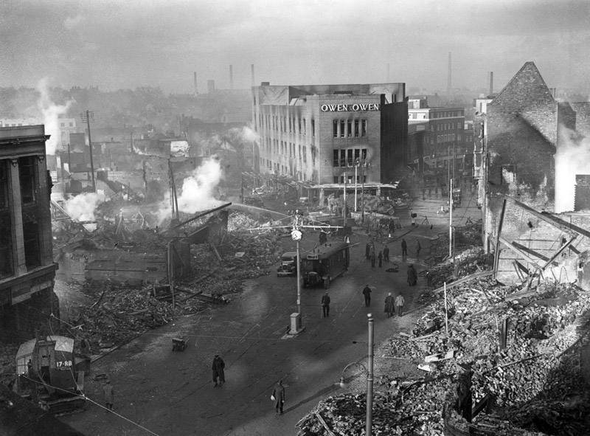
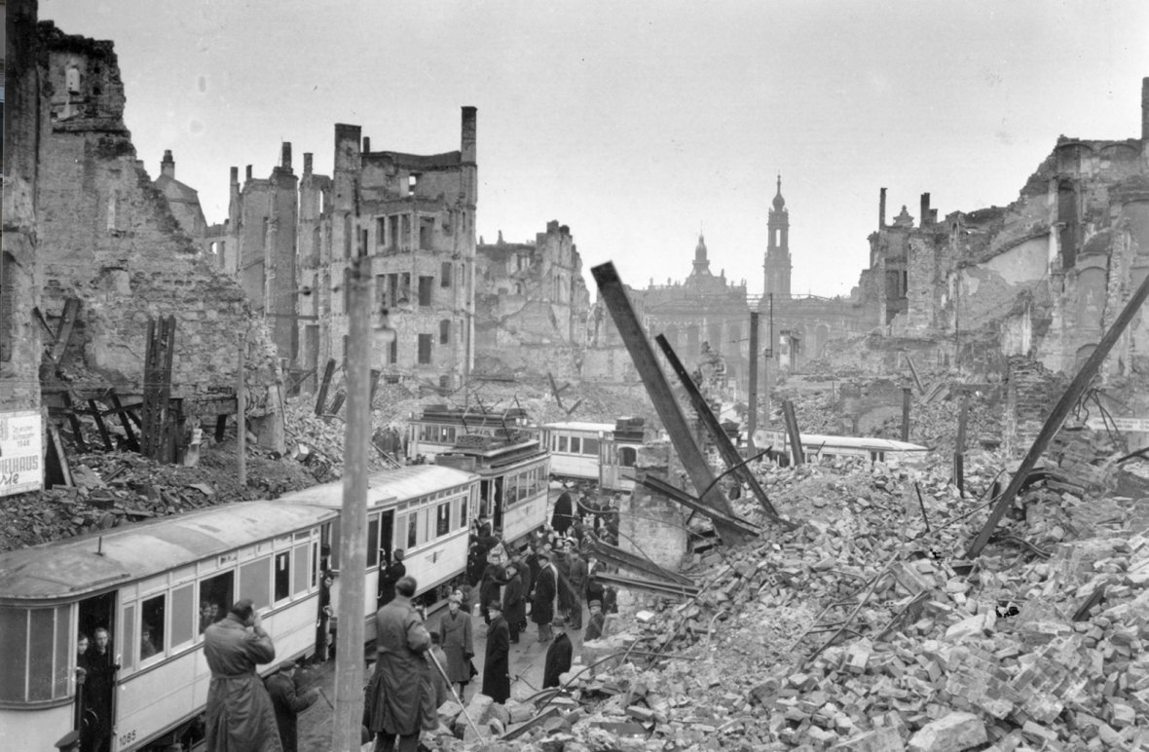
The Nature of War
Total War
  Mobilization extensive and required govt control of natural and labor resources
  Destructive technologies from WWI plus airplanes, rocketry, and the atomic bomb
Blurred lines regarding military and civilians; all subject to destruction

Slide 26
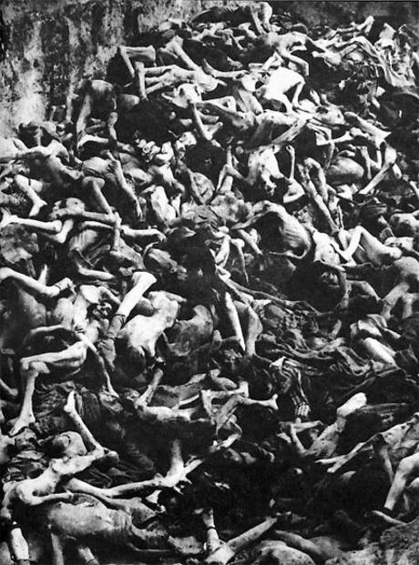
The Nature of War (cont)
Holocaust
  Mass extermination of targeted peoples
  Final solution
  Asphyxiation
  Medical experiments
  Camps
6 million Jews exterminated along with anyone who threatened the purity of the Aryan race
  Gypsies
  Homosexuals
  Polish Catholics
  Mentally and physically disabled

Slide 27
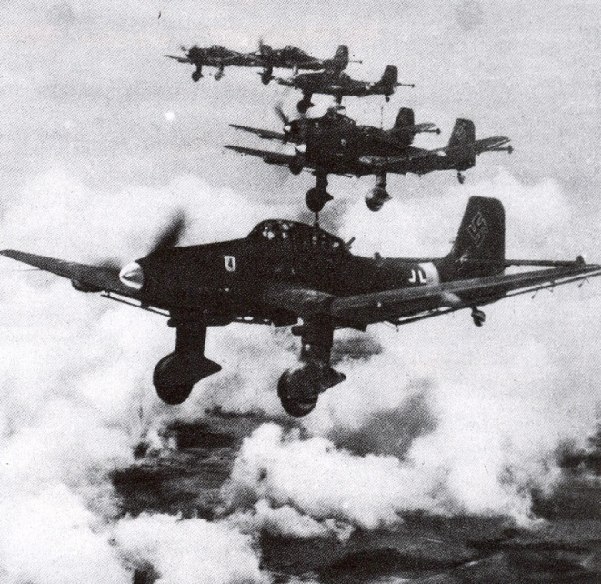
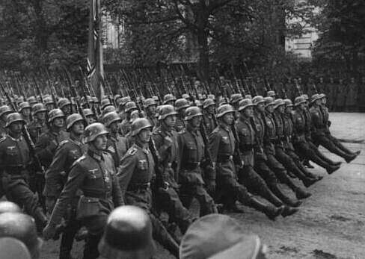
War in Europe and North Africa
Germans took advantage of new technology: blitzkrieg
  Fighter planes scattered enemy troops and disrupted communications
  Tanks rolled over enemy defense lines
  Infantry invaded and occupied lands
Poland, Austria, Norway, Denmark, Belgium all surrendered; France collapsed
  In France – German controlled Vichy
  French Resistance staged guerilla attacks
Britain stood alone resisting Germany until 1941; Russia and US joined

Slide 28
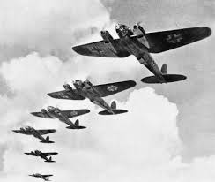
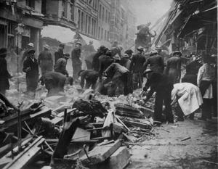
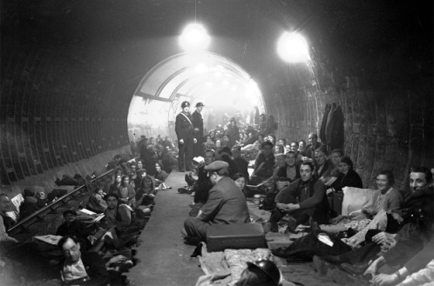
War in Europe and North Africa (cont)
Britain’s geography helped protect it
  Winston Churchill Prime Minister
  German Luftwaffe launched massive air attack
  Battle of Britain
    British Royal Air Force counterattacked German planes
    Hitler turned eastward to Russia (had signed non-aggression pact)
    Brought Russia in on the side of the Allies
      Hitler conquering but then winter set in
  Allies defeated Hitler at Stalingrad first major Allied victory
  US joined the war
  Strategy w/Britain to strike from N. Africa was successful

Slide 29
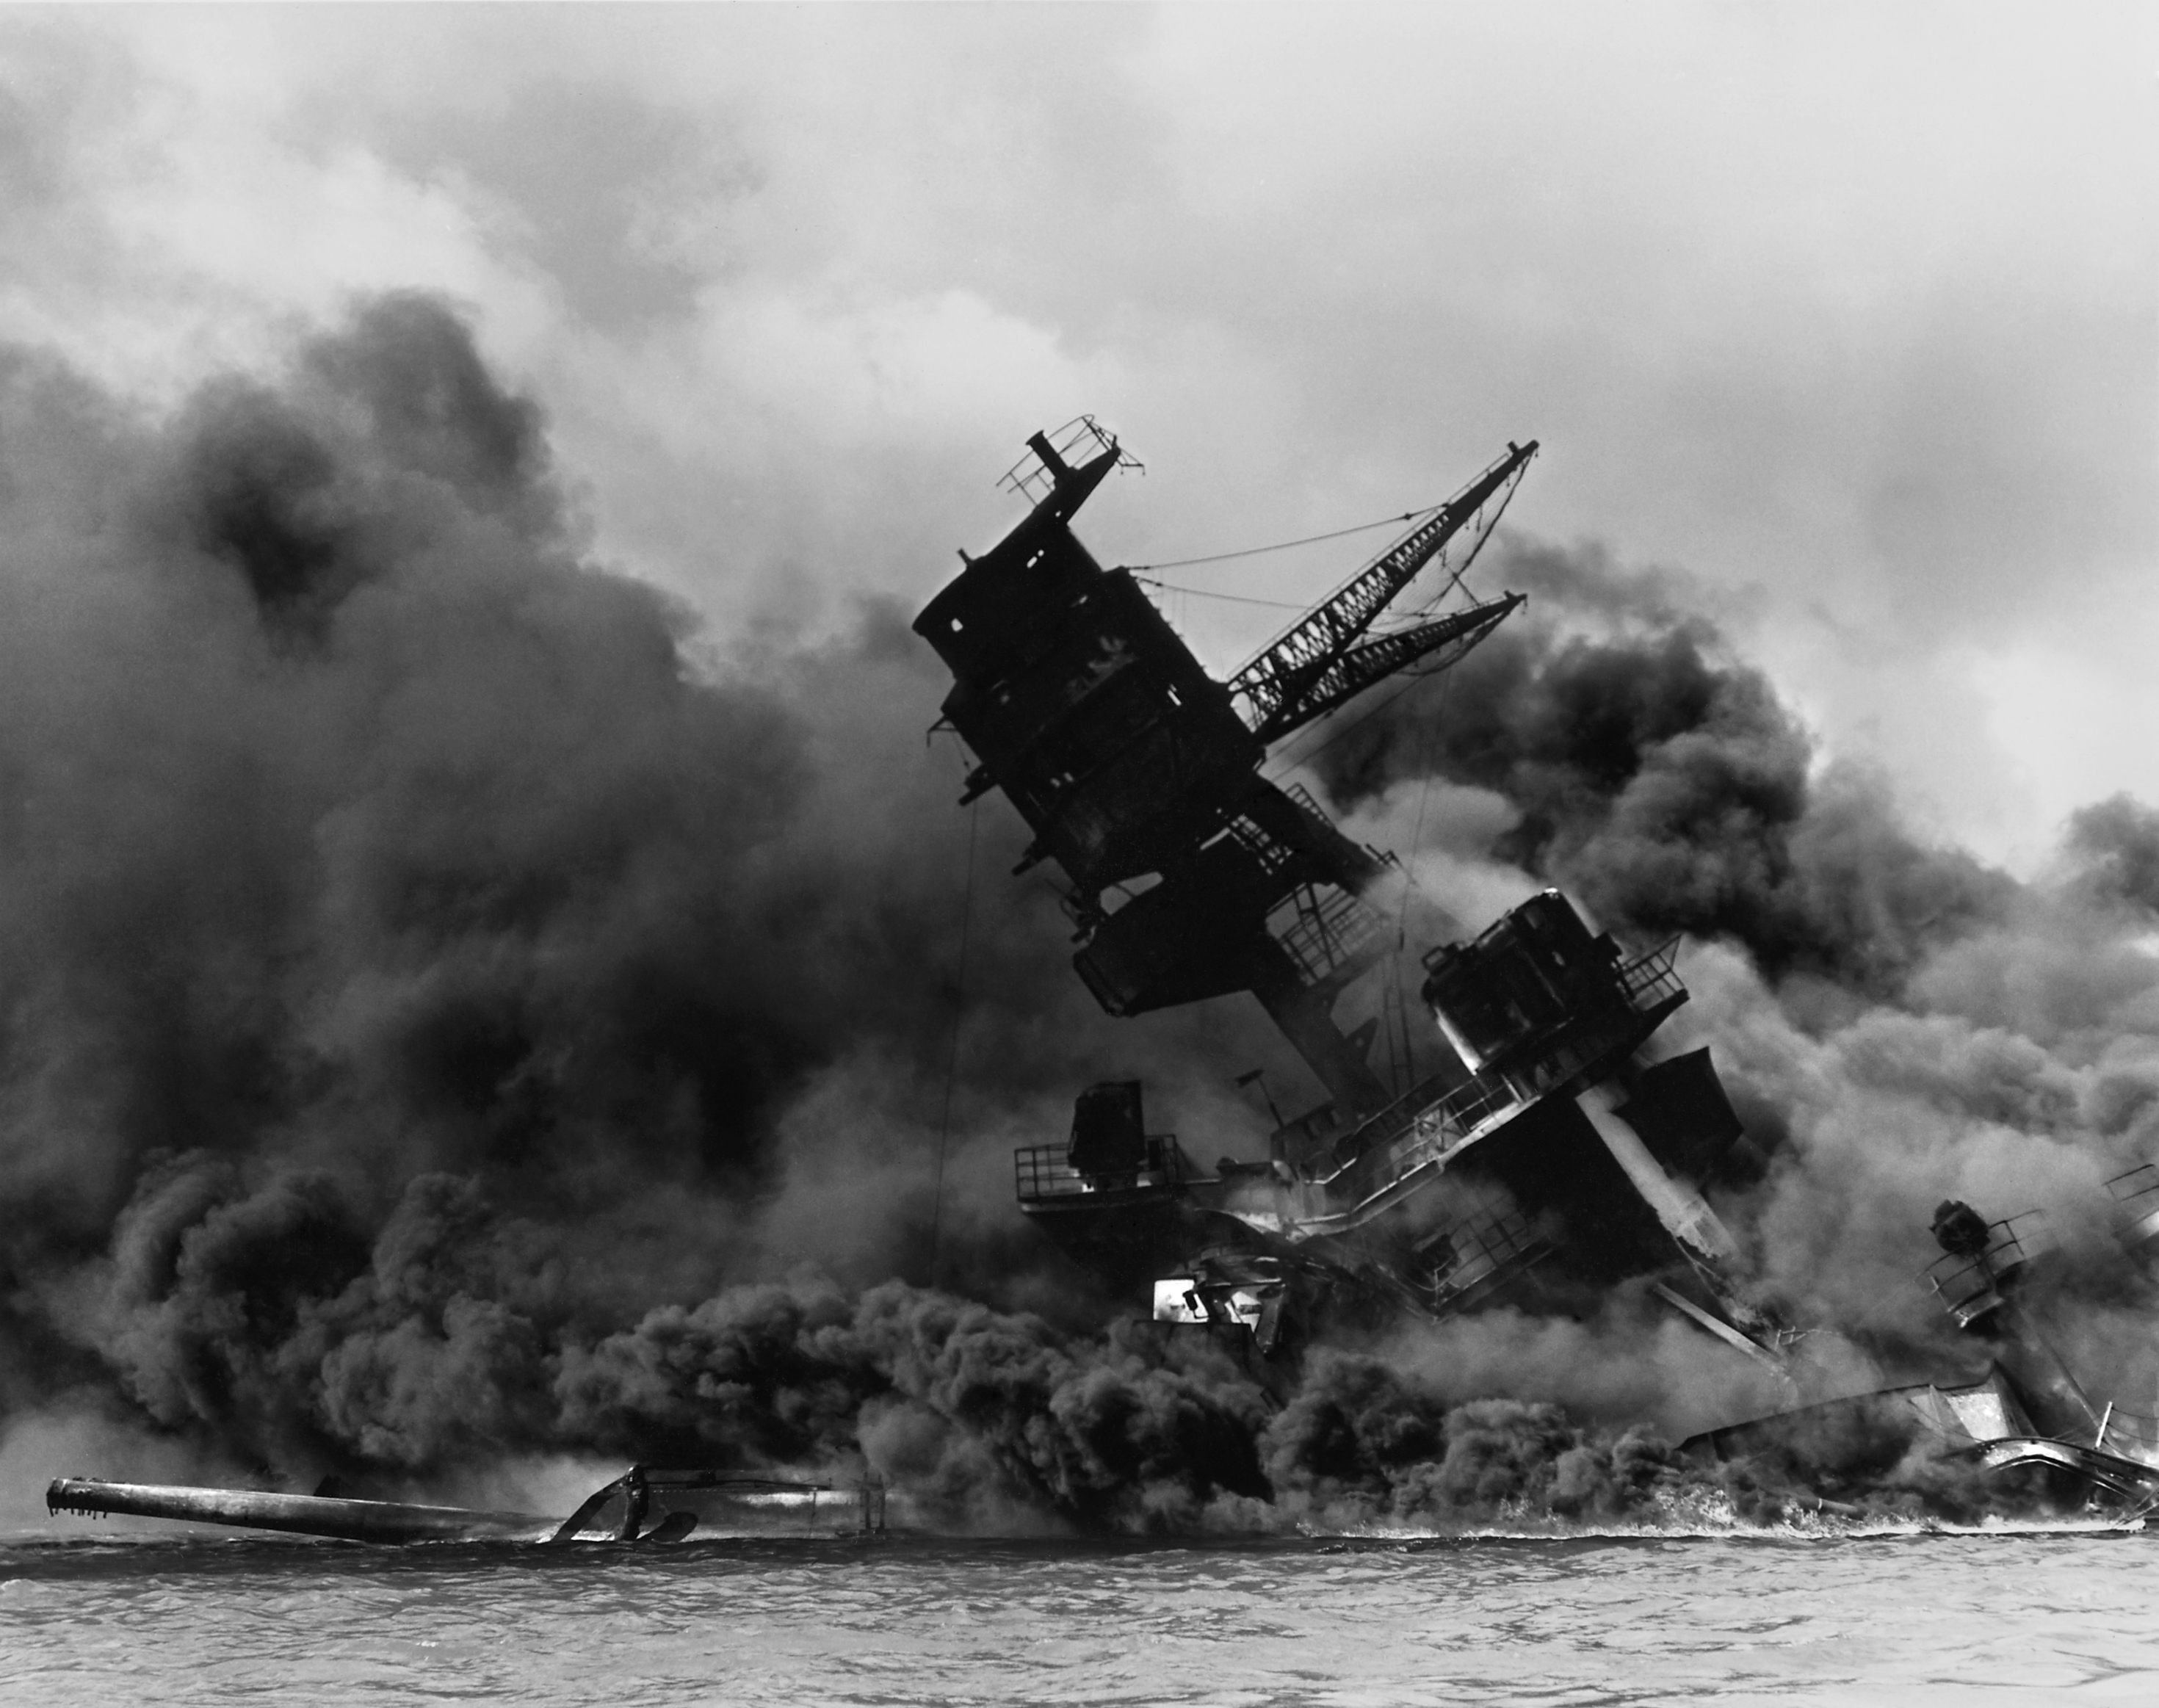
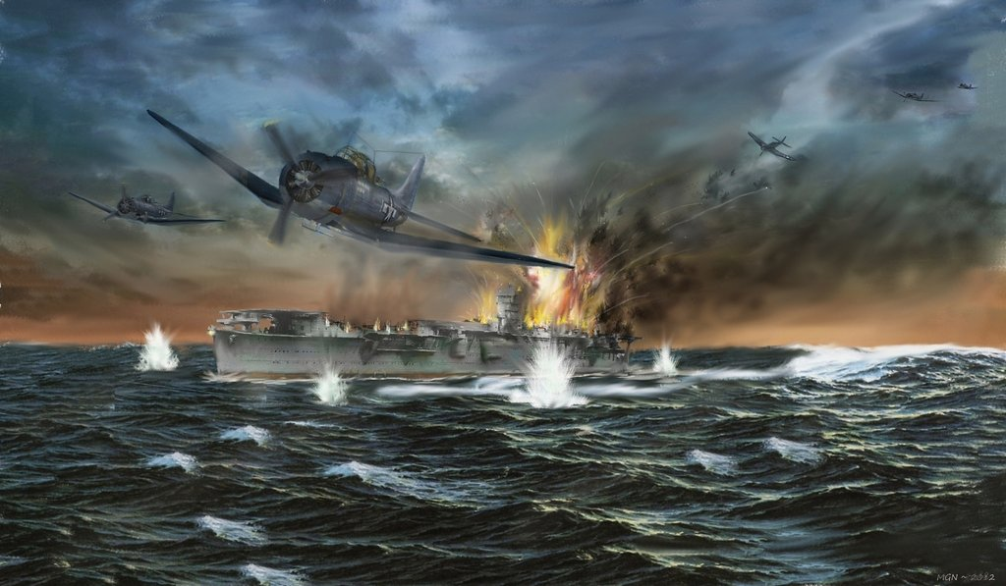
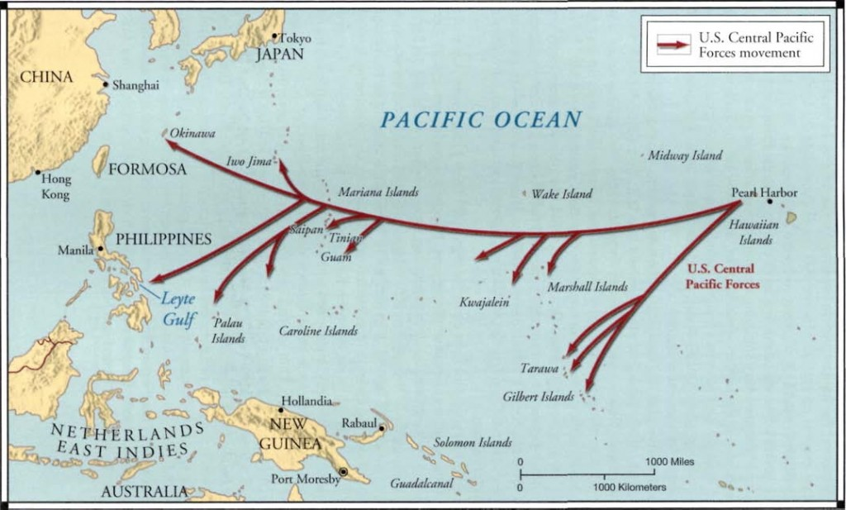
The War in Asia and the Pacific
France fell; Britain trying to protect its territories
  Japan saw their opportunity to seize European colonies in SE Asia
Britain and US stopped shipments of steel and oil to Japan
  US insisted Japan give up newly acquired territories
  Japan attacked Pearl Harbor, Dec. 7, 1941
    US declared war on Japan; had to rebuild fleet
    US stopped Japan in battle in the Coral Sea (1942)
      Battle Of Midway; US gaining momentum and began island hopping campaign

Slide 30
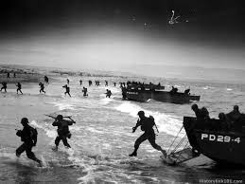
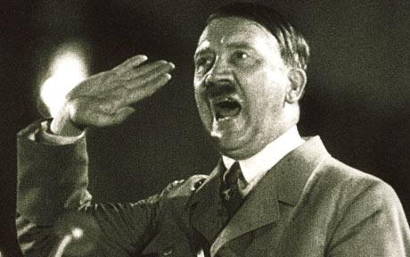
The End of the War
1942: Battle of Stalingrad was a major turning point
1943: Russian army began pushing Germans westward
Invasions across Mediterranean Sea and across the English Channel
  Italy signed armistice 1943
Allies D-day 1944
  Allies advanced on Belgium; defeated Germany at Battle of the Bulge
    US and France marched east across Germany; Russia marched west and met at the Elbe River.
1945 Hitler committed suicide and Germany surrendered

Slide 31
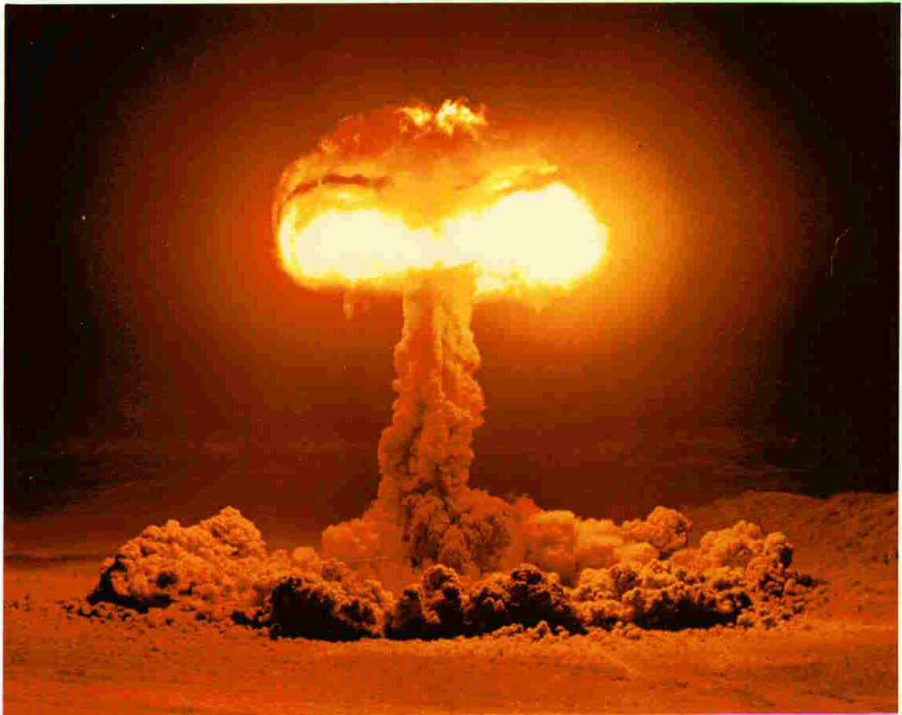
The End of the War (cont)
War in the Pacific continued
US dropped atomic bomb Hiroshima
  200,000 + die
    Japan refuses to surrender
  US dropped bomb on Nagasaki
    Emperor Hirohito orders surrender
WWII marked end of European domination
  Most widespread, deadliest war
Mid 20th century – interdependence greater than ever
  US and Soviet Union emerged to compete for control of technological knowledge and assert power over the world

Slide 32
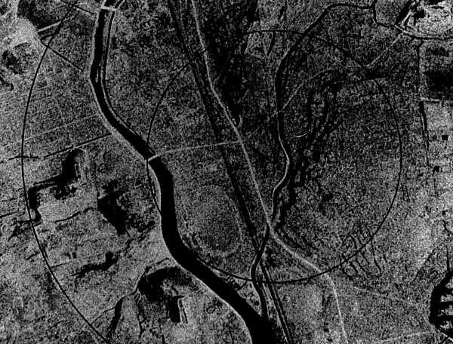
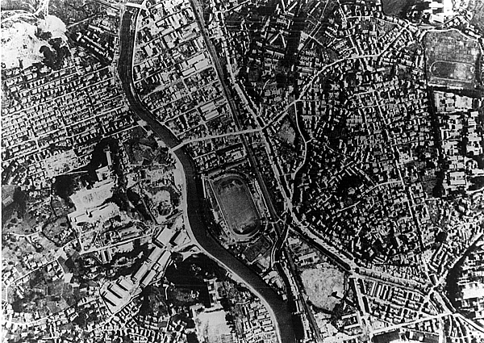
Nagasaki Before
After

Slide 33
The Atomic Bomb Controversy
Pros
Cons
Brought surrender of Japan; Allies won
Aggressive nations must be dealt with aggressively
Saved lives since it shortened war
Technology wins wars and must to be used
Bomb paved way to secure peace
Germany would have used it if they had it
Bombs killed civilians indiscriminately
Many died slow, agonizing deaths
US opened a Pandora’s Box of weapons
US should have warned Japan more clearly; Japan might have surrendered

