Slide 1
The History of Apartheid in South Africa

Slide 2
Apartheid
Laws enacted in 1948 by the National Party, racial discrimination becomes institutionalized
Passed 317 laws instituting apartheid
Classification of people into 4 racial categories: Black, White, and Coloured, and Asian
Race laws touch every aspect of social life
Equivalent—Jim Crow laws in the US

Slide 3
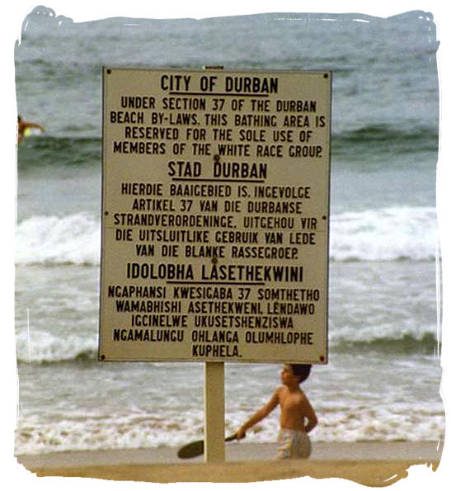
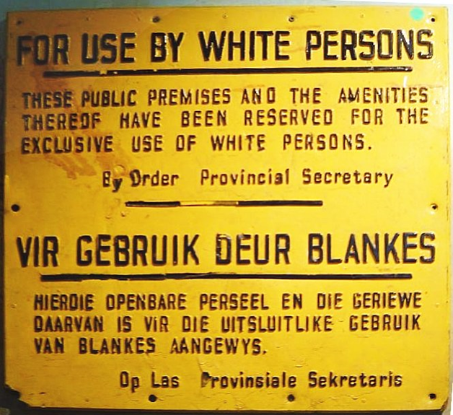

Slide 4
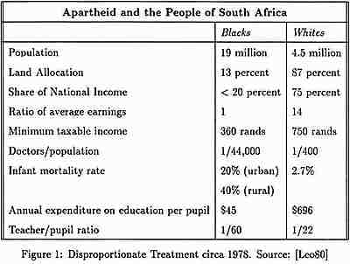

Slide 5
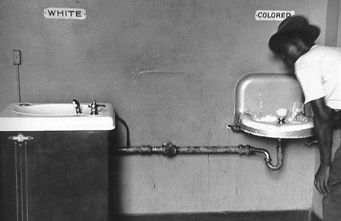
United States

Slide 6
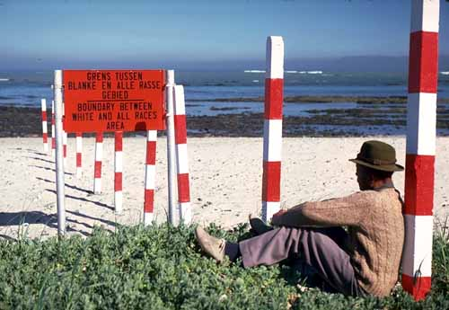

Slide 7
The Pillars of Apartheid
Population Registration Act
  Grouped every South African into a particular race. Only whites could vote and hold political office.
Mixed Marriages Act
  Made it a crime for any marriage to take place between whites and any other racial group. Only 75 marriages between blacks and whites were recorded before apartheid began.

Slide 8
Pass Laws
  Designed to control the movement of Africans. If an African were stopped & found without a passbook, could be jailed
  Between 1948 & 1973, over 10 million Africans were arrested because their “passes were not in order.”
The Homelands
  Divided Africans into 10 ethnic groups and were assigned a “homeland that were declared independent of the South African gov’t
  Homelands made up 13% of the land for about 75% of the population.

Slide 9
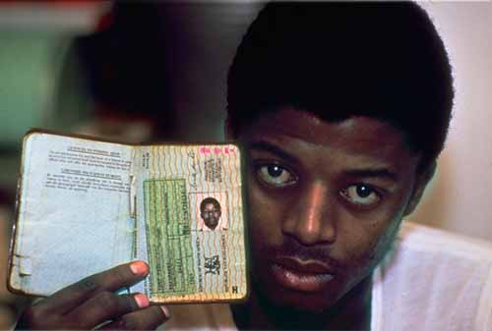

Slide 10
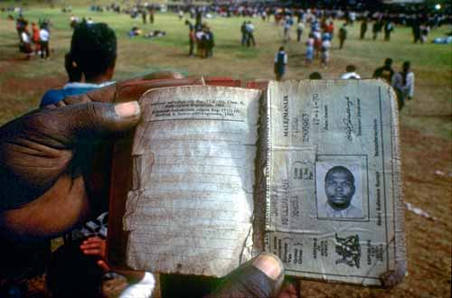

Slide 11
Video Clip: POV—Living under apartheid
http://www.pbs.org/pov/twelvedisciples/video/living-under-apartheid-clip-1-of-2/#.UqMx5Y01Azp

Slide 12
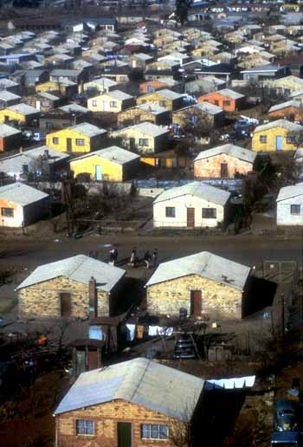
Homelands
Semi-independent areas occupied
by blacks
Gov’t allowed some to live outside homelands
  To work certain jobs
  Families were split

Slide 13
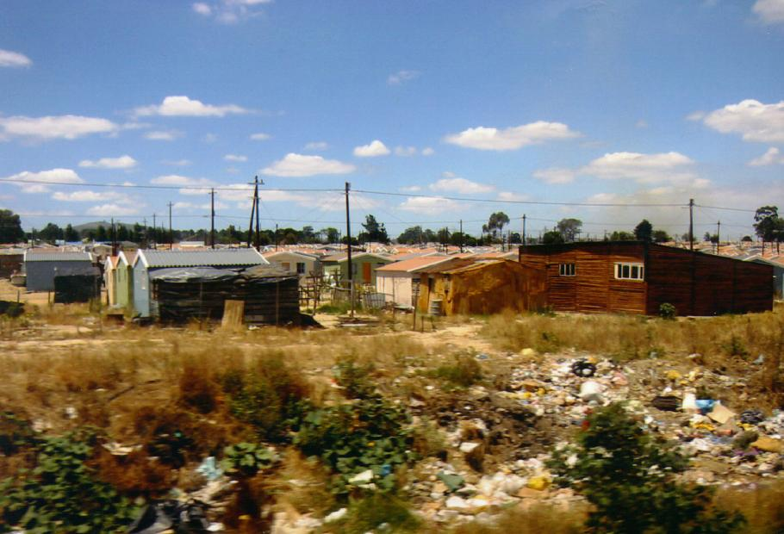
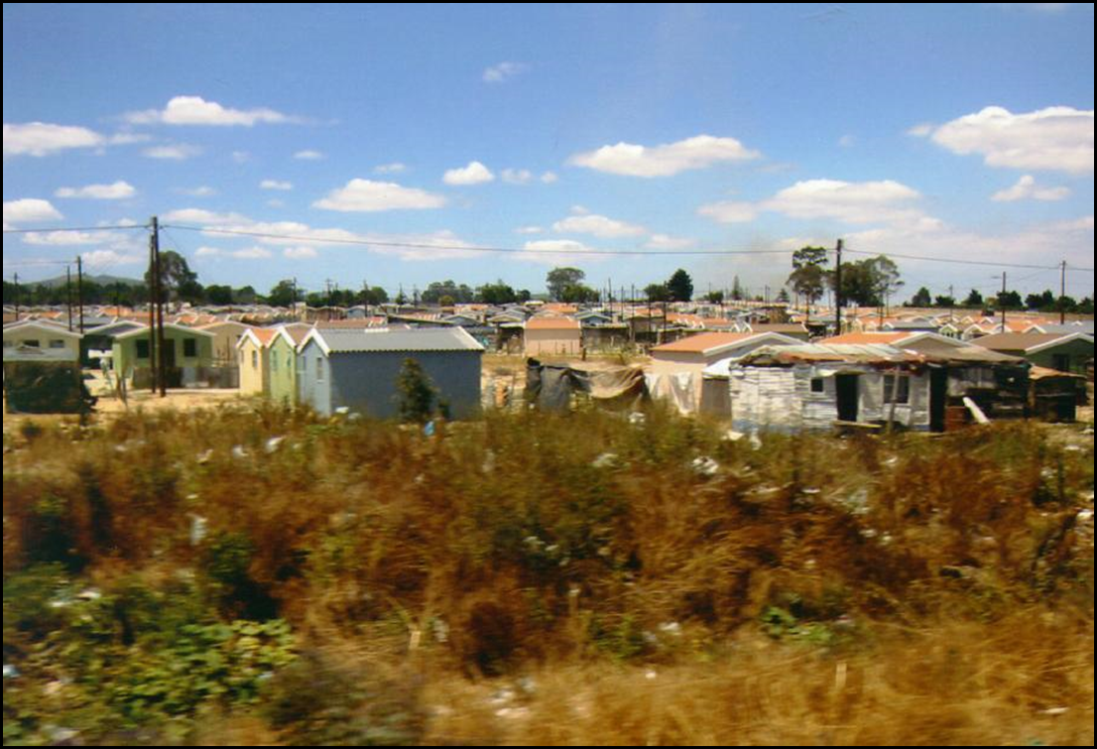
Shanty Town-Cape Town

Slide 14
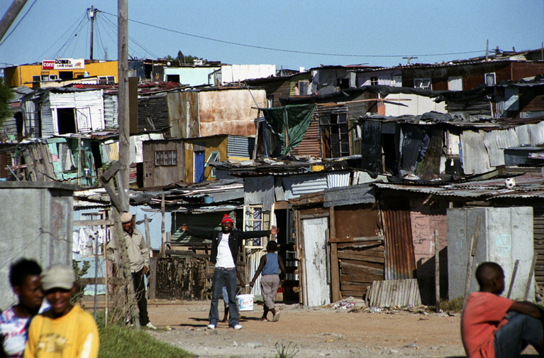
Shanty Town

Slide 15
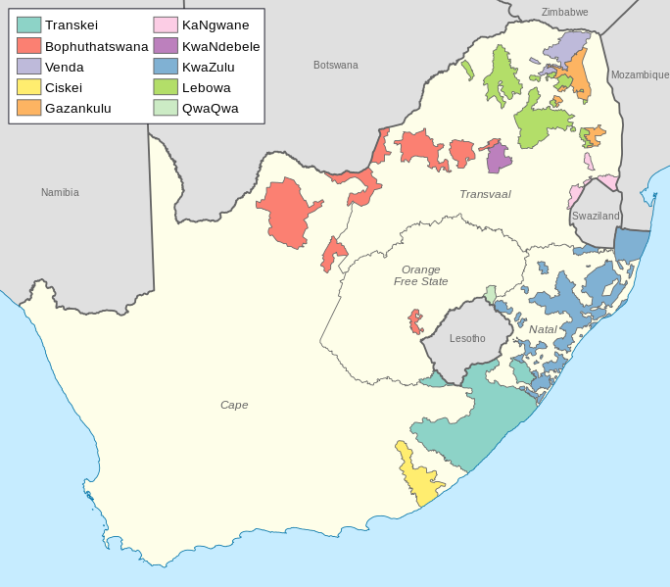
Homelands

Slide 16
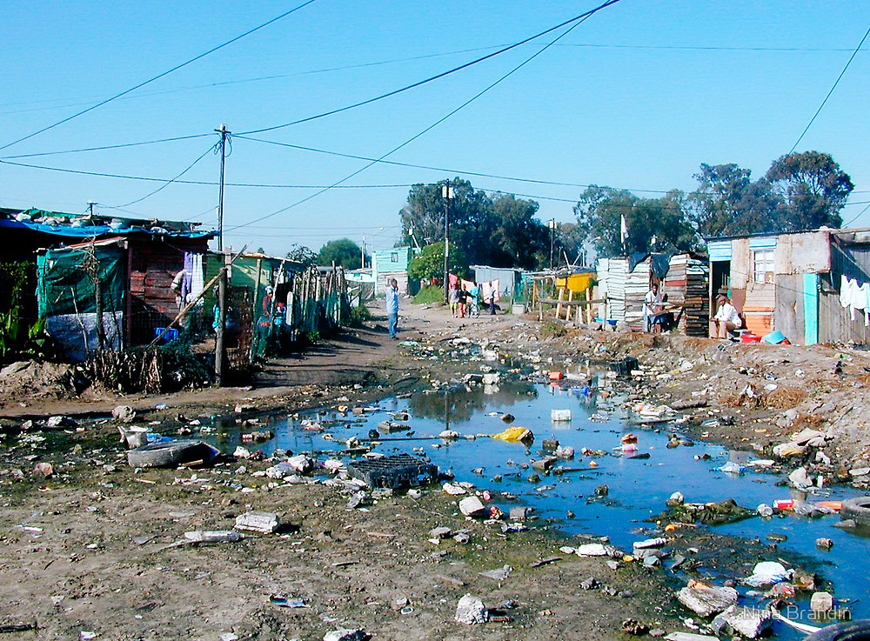

Slide 17
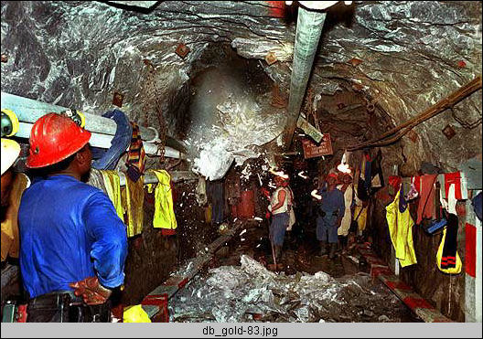

Slide 18

African National Congress
ANC created to speak on behalf of black civil rights
Founded in 1912
Responded to apartheid with peaceful nonviolent protests

Slide 19
Sharpeville Massacre
March 21
*On this date in 1960, police in Sharpeville, near Johannesburg, fired on
Black South Africans protesting racially biased pass laws.
The protesters suffered 72 deaths and more than 200 injuries in two days of violence
Turning Point: ANC opted to change its tactics and use violence
  Mandela went underground to wage guerilla war against the gov’t

Slide 20
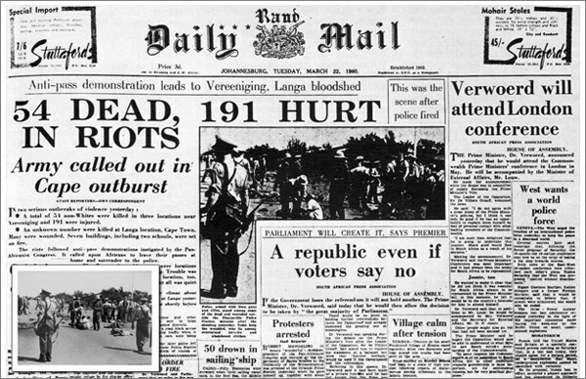
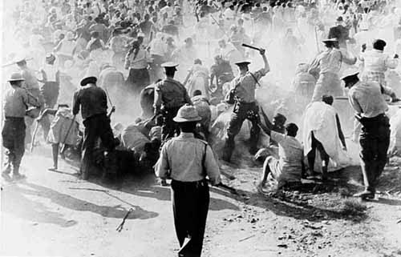

Slide 21
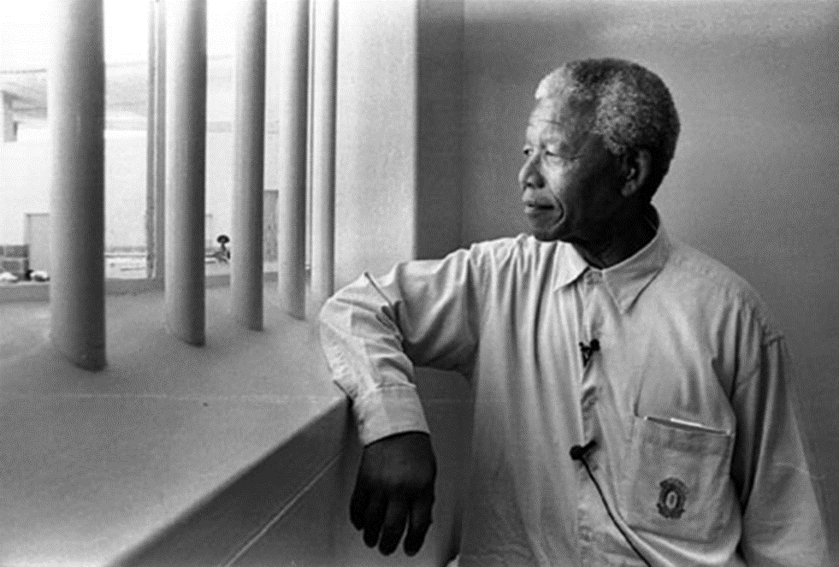
Nelson Mandela
Born1918 & after father’s death became the ward of
the acting regent for the Thembu nation.
Joined the ANC to oppose apartheid
Arrested in 1956
After Sharpeville Massacre, went underground and committed guerilla attacks
1962 (45 yrs. Old) sentenced to life in prison (sabotage & conspiracy to overthrow gov’t)
Sent to Robben Island, 7 mi. off the coast, cut off the from the outside world
ANC was banned
Mandela remained in jail for 27 years until 1990.

Slide 22
Video Clip: Mandela’s First TV interview
http://www.openculture.com/2013/12/nelson-mandelas-first-ever-tv-interview.html

Slide 23
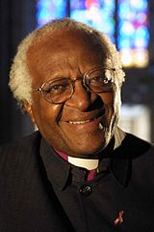
Desmond Tutu
Another leader against apartheid
Religious leader
"If you are neutral in situations of injustice, you have chosen the side of the oppressor. If an elephant has its foot on the tail of a mouse and you say that you are neutral, the mouse will not appreciate your neutrality."

Slide 24

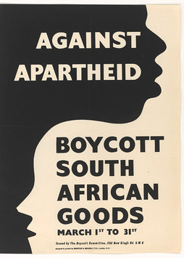
How did the world react to Apartheid?
A lot of countries boycotted South Africa during Apartheid: they refused to buy its products.
Film and pop stars refused to perform in South Africa

Slide 25
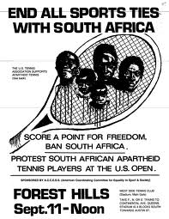
The world of sports against Apartheid
South Africa was absent from international sport events for most of the apartheid era due to sanctions
A lot of teams and champions refused to compete either in South Africa or against South Africa

Slide 26
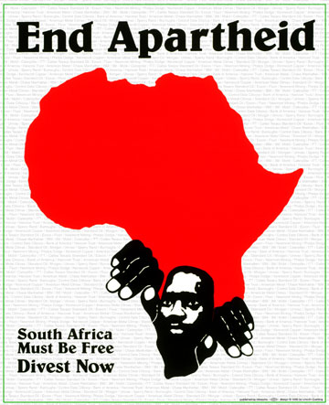


Slide 27
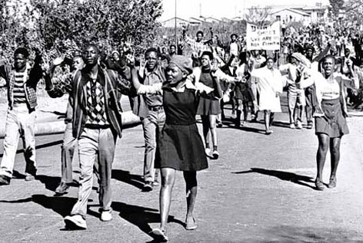
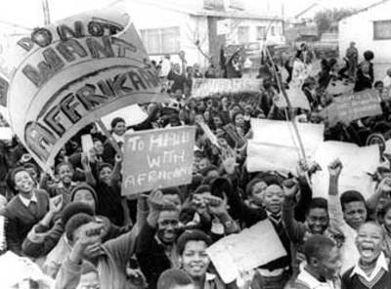
Resistance to Apartheid: Soweto Uprising
ANC played an important role, not always peaceful
Schoolchildren a major source of protest
1976 Soweto riots: prompted by introduction of Afrikaan’s language as language of instruction in schools
Torture, imprisonment, rigged trials widely used against activists; state of emergency
Serious political violence in the townships throughout 1980s (e.g., rent boycotts, militant youth)
Violent confrontation; outright war seemed likely before apartheid’s end

Slide 28
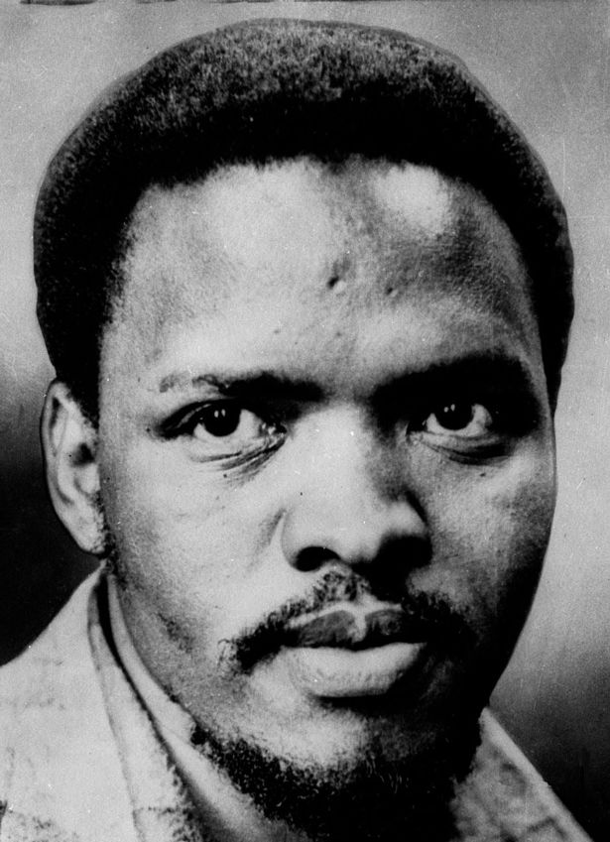
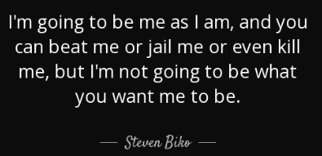
Resistance: Stephen Biko (1946-1977)
Black student activist
Leader of Black Consciousness Movement
Arrested and died of a “Hunger Strike”
  beaten to brink of death
  didn’t make it to the black hospital in time

Slide 29
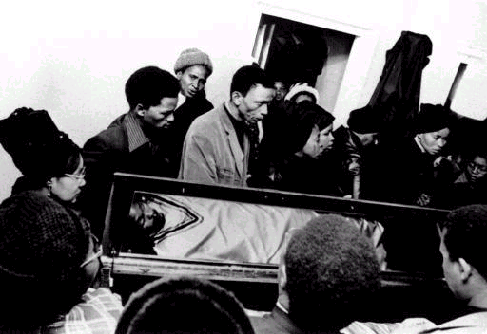
Biko funeral

Slide 30
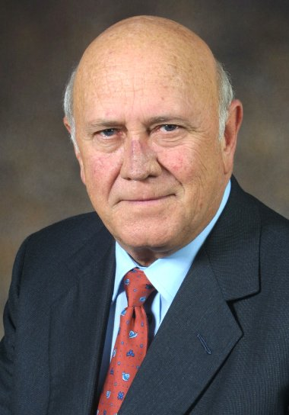
Why did apartheid end?
Cost of apartheid for white minority became too great
Economy stagnant
World trade sanctions
F. W. de Klerk became president of S.A. in 1990
  Legalized the ANC
  Began negotiations to end apartheid
  Released Mandela from prison

Slide 31
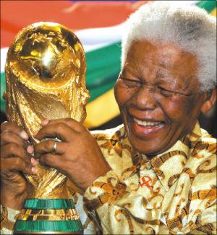
The first black president: Nelson Mandela
Most important anti-apartheid leader
Spent 27 years in prison to for a free
South Africa
1994 became the first black president
(75 yrs old) after the first free elections in
South Africa: for the first time the black people could vote in their own country.

Slide 32
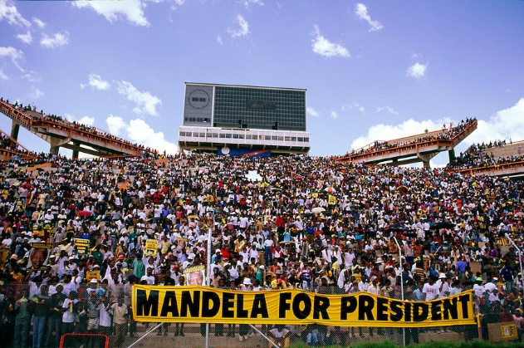
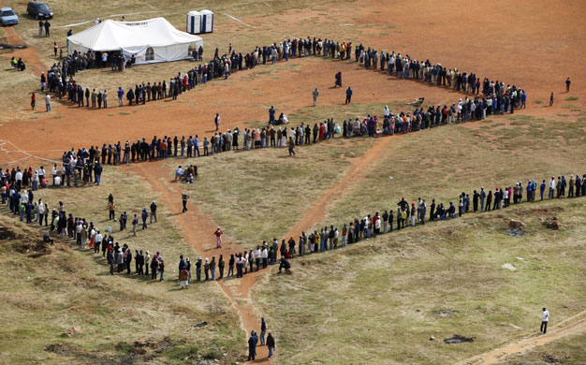
Waiting in line to vote, 1994

Slide 33
South Africa Today
Apartheid is not the law anymore
However, it will take years to erase the damage it did.
The ANC has had LOTS of corruption
For instance: Today in South Africa the average income for whites is still 10 times
what it is for blacks.

